Slide 1



POWRR Tools:
Lessons Learned from an IMLS National Leadership Grant
NDSR Immersion Program
Day 2
Lynne M. Thomas
Digital POWRR Project, Northern Illinois University
Notes:
Have one of the extras go around and do a quick test to make sure DA will run on the attendees’ machines
NEED TO ADD LANGUAGE THAT SAYS WE DO NOT RECOMMEND OR ENDORSE ANY ONE TOOL/SERVICE
AAISHA Hand out pretests as people walk in

Slide 2
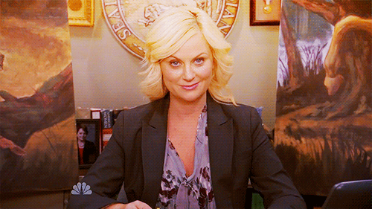
Source
…and Leslie Knope

Slide 3
MORNING
AFTERNOON
Now – 10:30
Solution in Theory vs. Solution in Practice & Tools Overview
10:30 → Break
10:45 – 11:40
POWRR Tools Overview & Q&A
1:30 – 2:15
Advocacy, Policy, Potential Solution Models
2:15 – 3:00
Assembling Your Team
Your 3-3-3 Action Plan (Activity)
Q&A
LUNCH!

Slide 4
Expected Outcomes
You will understand that different digital preservation tools/services can perform different functions within the digital curation lifecycle, and be able to explain how these tools/services can be used within your institution’s workflow.
You will understand that it is unlikely that a single tool, a single approach, or a single person will be able to meet all of any organization’s digital preservation needs. Sustainability requires plurality.
You will understand that the biggest challenge to implementing sustainable digital preservation in organizations is not technology or tool selection: it’s advocacy & funding.
You will take away resources that help align communication and advocacy, policymaking, and tool selection/implementation.
You will create a 3-3-3 Action Plan to implement in the following 3 months that will move you closer to your digital preservation goals.
Notes:
DANIELLE

Slide 5
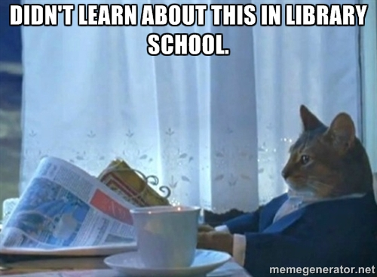
Actual Conversation, ca. 2004
“I’d like our institution to be the home for your literary papers.”
*gets handed flash drive*
Notes:
This is basically where I began.

Slide 6
Source
What can we do?

Slide 7
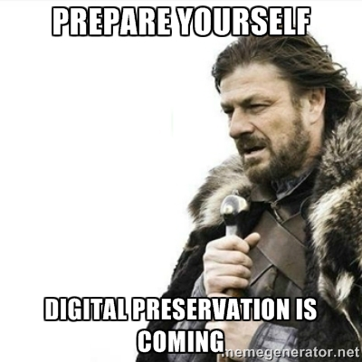
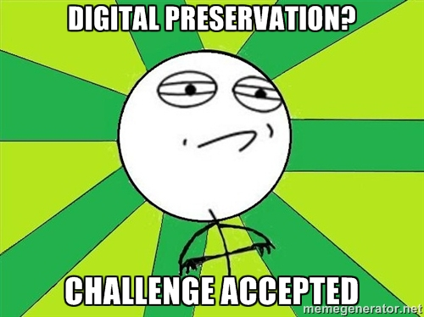
2005-2008
FEAR
HOPE

Slide 8
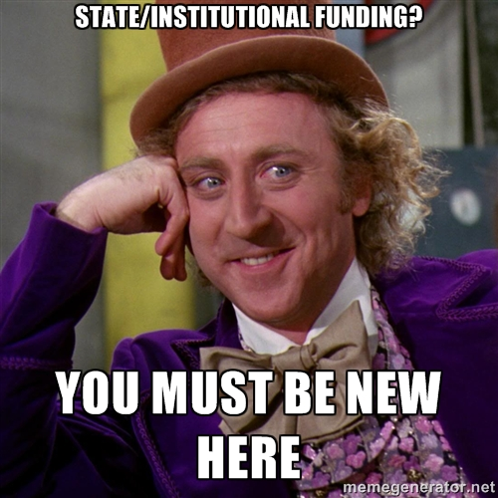
Early education
CARLI Digital Preservation Subcommittee 2004-2007
2006 CARLI White Paper

Slide 9
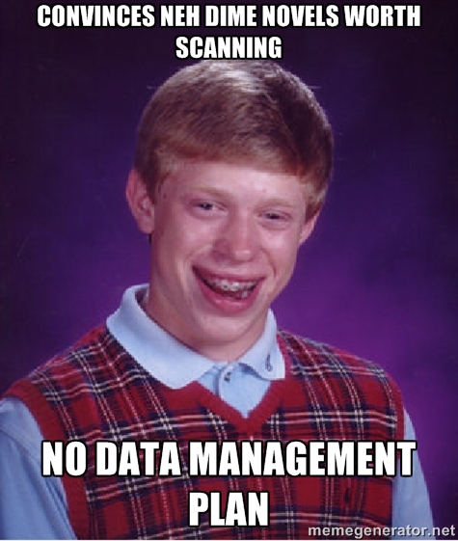
Turning point: 2008 grant application
… We are probably not the only ones with this problem…

Slide 10
Source
What can we do?

Slide 11
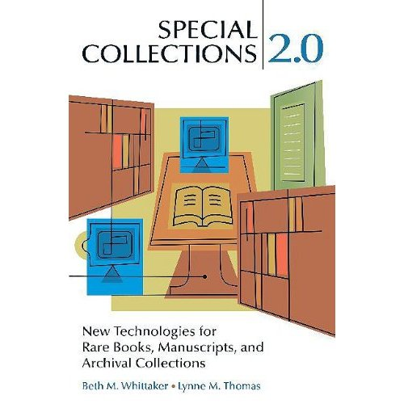
Doing the research (2009)
Primary author on digital preservation chapter & appendix
I survived reading the OAIS standard --- and realized my library would never meet it.

Slide 12

… What about our consortium?
They bought us lunch and provided meeting space.
They also eventually wrote a letter of support for the IMLS grant application.
Source

Slide 13
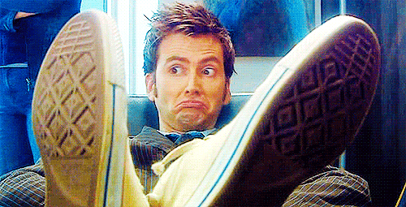
In the meantime, we tried to advocate for resources on our own campuses.
“We can’t even afford test tubes for CHEM 101.”
“All that’s just on the internet, it’ll always be there.”
“There’s a hiring freeze on campus.”
Source

Slide 14
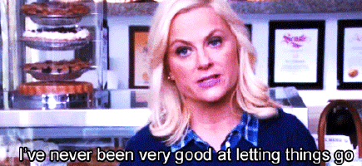

Slide 15
What can we do?

Slide 16
We submitted an application…

Slide 17
What we said:
POWRR: Bigger schools have taken care of the problem! We’ve been left behind! Our materials are valuable, too!
*request nearly $1M to set up system for less well resourced libraries that looks like a big private LOCKSS network*.
  5 institutions
  Different systems
  Different sizes
  Different job roles
  All under-resourced

Slide 18
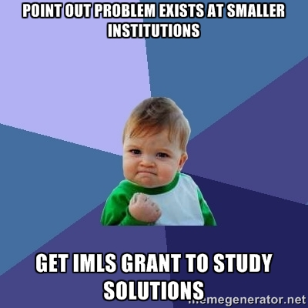
And the IMLS responded in 2011.
IMLS: Yes, that *is* a problem. Your solution won’t work, though. Here’s $500K. Be sure to look at cloud computing.
Rewrite of grant, plan of work, and budget to new remit

Slide 19
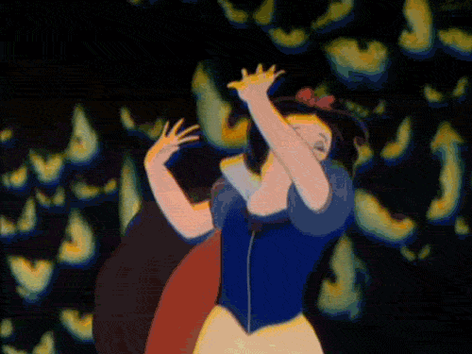
I had a lot to learn.
Grants admin
Assessment
Hire Project Director
Find Advisory Board
Change of Program Officer
Source

Slide 20
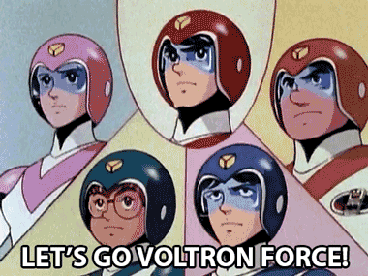
Our Intrepid Advisory Board
Liz Bishoff
Steve Bromage
Martin Halbert
Jerome McDonough
Christopher J. Prom
Amy E. Rudersdorf
Source

Slide 21
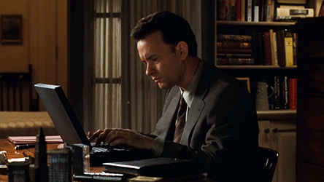
Once we got all of that in place…
We didn’t really know where to begin. Or how.
(This is a theme).

Slide 22
What can we do?

Slide 23
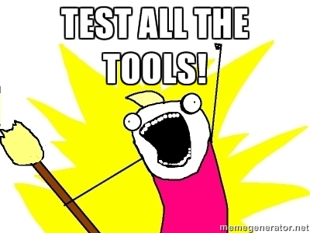
Librarian inclination #1:

Slide 24
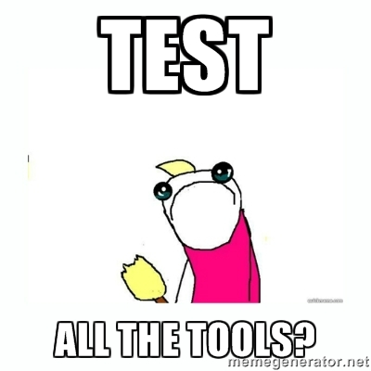
*Googles “Digital Preservation Tools”*
That’s… a lot of different kinds of tools (60+).
How on earth will we choose?
Is our data even testing-ready?

Slide 25
What can we do?

Slide 26
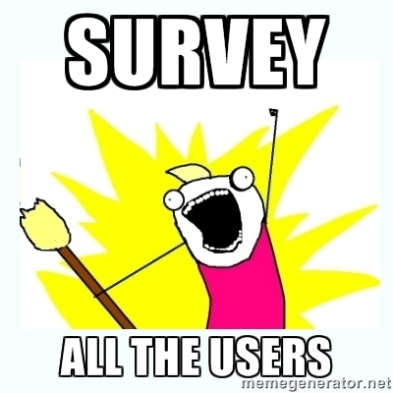
Librarian inclination #2

Slide 27
What do we know?
Begin with the library. Then the campus.
How much data?
What kinds of formats?
Will we keep all of it? Where?
Do we have a plan? A policy? A plan for a policy?

Slide 28
What don’t we know?
Just how much digital stuff in need of saving is there on our campuses?
Does campus IT know?
How about our Administrators?
Do our faculty even know that this is a thing?

Slide 29
Tool-testing things we hadn’t considered
“You'll need a virtual machine for that”
“You just need to run a Python script”
“You don’t have access to that server”
“You can’t transfer 1TB of data over a 100MB line.”

Slide 30
Also:
You can’t make good choices without good information and lots of campus wide buy-in
You will miss hugely important details based on not knowing different organizational practices outside your purview

Slide 31
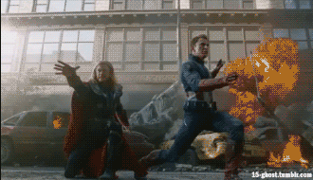
We tried to make our survey do 2 things at once
Write an IMLS White Paper for our Study
Solve the actual problem
… These are not always going to bring us to the same conclusions
Source

Slide 32


Where do people keep their data?

Slide 33
Aware of data protection policies?

Slide 34
POWRRful Lessons:
We learned from each other’s campus survey experiences
We do not have technology problems; we have selection, advocacy, infrastructure, and resource access problems from which tech problems develop.
Stubbornness is a necessary virtue.
The roadblocks you anticipate are not necessarily the ones that appear.

Slide 35
We still weren’t ready to select tools.
We needed
Better understanding of how to apply standards to us.
Better method to explain need to others.
Way to sort/eliminate tools at a glance.

Slide 36
What can we do?

Slide 37
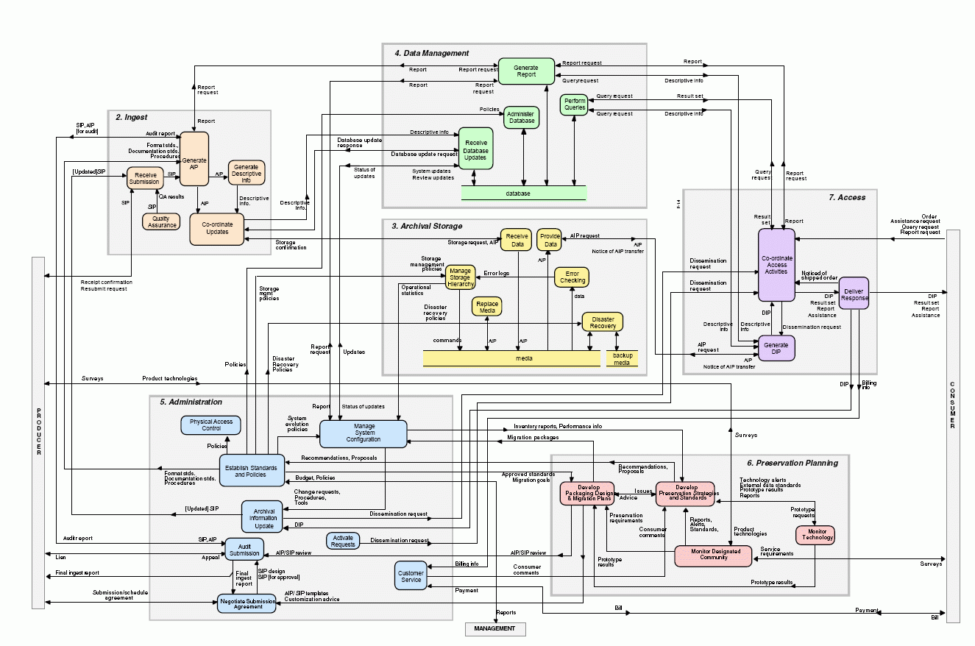



How do we get from here to there?
Solution in Theory
Solution in Practice
vs.
Scary OAIS Spaghetti Monster
Notes:
JAIME
Solution in Practice: Figure out what you have, start talking to people, build a team and eventually a policy!

Slide 38
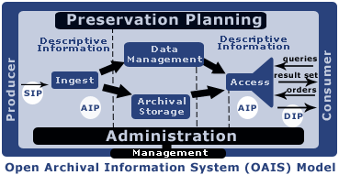
Solution in Theory
OAIS (Open Archival Information Systems) and other schematic models
TRAC Certification (Trustworthy Repositories Audit & Certification)
TDR ISO 16363 (Trustworthy Digital Repository ISO Standard)
Curation Lifecycles that don’t look a thing like our current workflows
SIPs, AIPs, DIPs, Oh my!
Notes:
JAIME ACTUALLY GO OVER WHAT AIPS SIPS AND DIPS ARE..>USE THE SIMPLIFIED LANGUAGE WE PUT IN THE WHITE PAPER
In just over 10 years, there are 5 repositories that have been able to become certified!!! (Chronopolis Report; Hathitrust Report; Portico Report; Scholars Portal; CLOCKKS, which received the highest score of any org) Meg’s Note: OAIS was conceived in 1996 and accepted as an ISO standard in 2002. And there are actually only two TRAC certified per the CRL info I sent with my White Paper feedback (http://www.crl.edu/archiving-preservation/digital-archives/certification-and-assessment-digital-repositories)!
In the intro (to the 90 page document called the TRAC Criteria & Checklist,” the process came out of an identified need…
“The [OAIS] reference model (ISO 14721) provides a common conceptual framework describing the environment, functional components, and information objects within a system responsible for the long-term preservation of digital materials. Long before it became an approved standard in 2002, many in the cultural heritage community had adopted OAIS as a model to better understand what would be needed from digital preservation systems.
“Institutions began to declare themselves ‘OAIS-compliant’ to underscore the trustworthiness of their digital repositories, but there was no established understanding of ‘OAIS-compliance’ beyond meeting the high-level responsibilities defined by the standard. There were certainly no criteria for measuring compliance.”

Slide 39
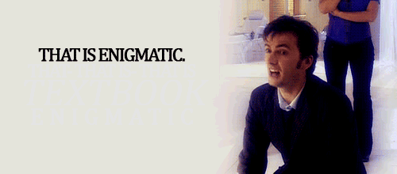
Source
#GPOY

Slide 40
Our Dilemma
What if, as we suspect and fear, we can’t actually meet the standards, despite our best efforts?

Slide 41
What can we do?

Slide 42
We can be ready.
We can intellectually map how digital preservation works to how we work.
We can upgrade our metadata and recordkeeping practices for the next steps.
We can triage our data for ingest.
We can build policies and plans, which in turn help us choose tools.
We can better educate ourselves, our stakeholders, and our funders.

Slide 43
How Digital Preservation Activities Map to How Libraries/Archives Work
We already perform many of these functions, we just name them differently.
Getting it
And a few other
odds & ends…
Letting people use it
…or not!
Understanding it
&
Documenting it
Taking care of it
Notes:
JAIME

Slide 44

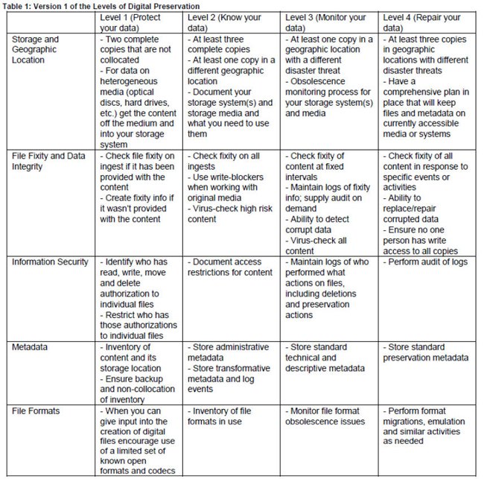
http://www.digitalpreservation.gov/ndsa/activities/levels.html

Slide 45
What can we do?

Slide 46
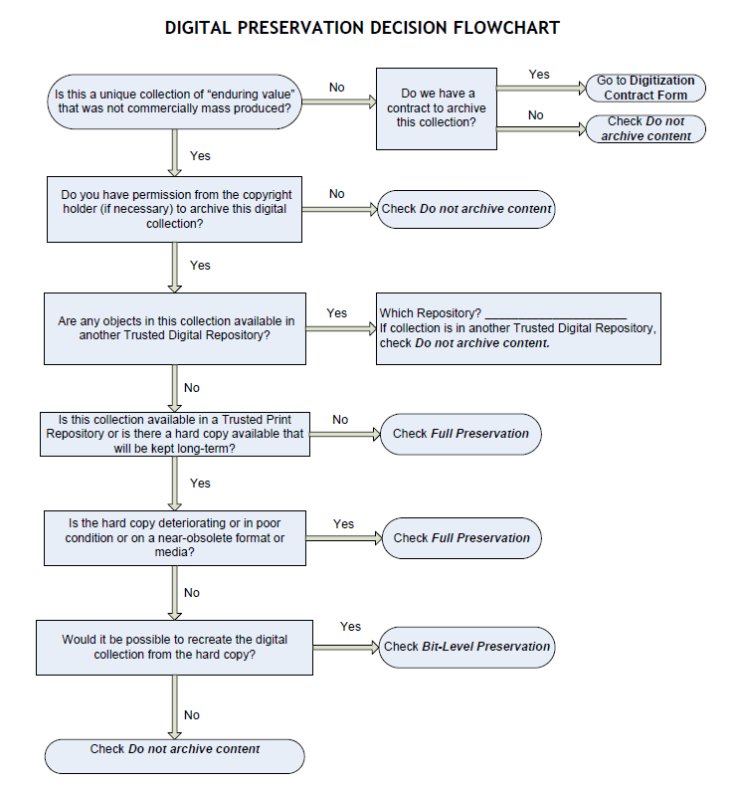
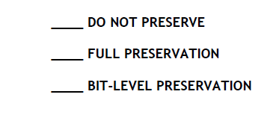
SELECTION.
Courtesy of:
Tawnya Keller, Digital Preservation Archivist
University of Utah
Notes:
DANIELLE
Note that this is in their handout and has a side 2 to help them articulate different decision points.

Slide 47
BREAK

Slide 48
What can we do?

Slide 49
We can evaluate tools.
The same way we evaluate any other potential tools.
  We look at the product websites, the communities, and online discussion groups.
  We search for pricing. And complaints.
13 POWRR project members = research 5 tools each
The grid came out of a wish to compare apples to apples. And a love of spreadsheets.

Slide 50
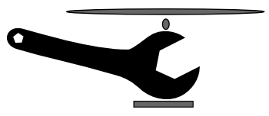
The Digital POWRR Tool Grid
Tool capabilities digital curation lifecycle functions NDSA levels of preservation
“Snapshot” when we filled it out
Now maintained through COPTR.
http://coptr.digipres.org/Main_Page
http://www.digipres.org/tools/
Notes:
Community Owned Preservation Tool Registry

Slide 51
Solution in Practice is Iterative
What we tell our workshop attendees…..
    Not all tools and services are created equal.
    Choices of tools are not forever. They serve what you need now, selected with an eye to later.
    Starting small is good enough! A simple tool may still move you closer to your goals.
    Knowing what you have is crucial. Documentation more so.
    You already have many of the necessary skills!
Notes:
JAIME Monologue to talk them off the edge. You don’t have to pick the tools/services that will do ALL of the steps from the get go. Start with a step or two. And it doesn’t even have to be with a fancy schmancy tool!
CAVEAT: Time Sensitive. Software changes quickly. Like, REALLY QUICKLY. Reference COPTR

Slide 52
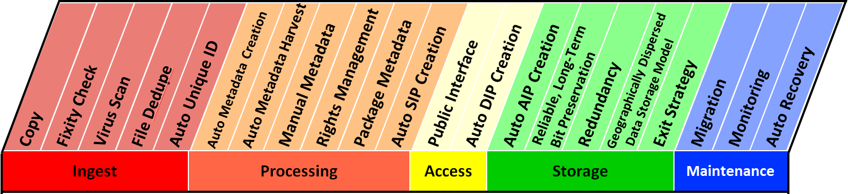
Mapping DP steps and functions to the NDSA Levels
…and also to how archivists & librarians think about collections.
Notes:
JAIME There is a handout in the packets that show our definitions for all of these.

Slide 53
What can we do?

Slide 54
Let’s Talk about Macroservices….
And there are back-end
storage/preservation services like…..
There are front-end/processing
tools like…..
MetaArchive
DuraCloud
Amazon Glacier
Internet Archive
Archivematica
Curator’s Workbench
Data Accessioner
BitCurator
There are even some services that will pretty much do it all like….
Preservica
Dspace Direct (uses DuraCloud)
ArchivesDIRECT
Note: Yes, there are also CMS’s, IR software, and Forensics tools….ugh. However, these are outside the scope of this workshop!
AND you have to figure out what works best with what!!!
Notes:
JAIME Having a basic knowledge of DP…they should already know the difference between storage and preservation. But it may come up as a question anyway.
Explain what we mean by processing and backend. Define difference between DP and IR.
Details on these specific tools later today. WE PROMISE.
NOTE ABOUT BITCURATOR: The BitCurator project proposed to build a software environment that would integrate digital forensics tools and methods into the workflows and collection management environments of libraries and archives, and that would support properly mediated public access to forensically acquired data. Using digital forensics approaches can help us ensure the authenticity, integrity, and provenance of digital materials.
The project was a joint effort between the School of Information and Library Science at the University of North Carolina-Chapel Hill and the Maryland Institute for Technology in the Humanities, and was funded by an Andrew W. Mellon grant between 2011-2014. They produced the BitCurator software environment, which is built on a stack of free and open source digital forensics tools and associated software libraries. BitCurator can be installed in a Linux environment, or run as a Virtual machine on top of most contemporary operating systems. Features of BitCurator include: pre-imaging data triage, forensic disk imaging, file system analysis amd reporting, identification of private and individually identifying information, and export of technical and other metadata

Slide 55
Macroservices: Doing it all! Sort of.
Using simple tools, like Data Accesioner, is what you can do while you are petitioning your institution for a more robust solution like…
        Archivematica
        Curator’s Workbench
        DuraCloud
        MetaArchive
        Preservica
        Internet Archive
Please Keep In Mind…
This is NOT exhaustive
Software changes quickly!
Based on availability at time of
testing and our perceived needs
Notes:
JAIME
These are tools we tested in 2013 as part of the IMLS-phase. Again, not an exhaustive list.

Slide 56
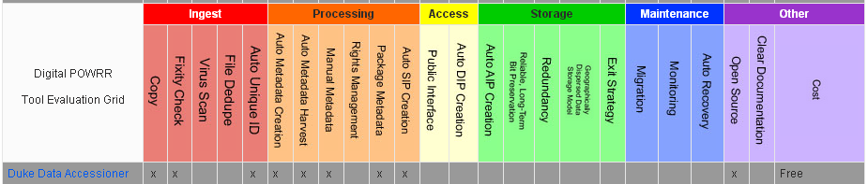
Data Accessioner
Notes:
DANIELLE Explain why we are demoing Data Accessioner
Go through this slowly…. DA was built out of the need for a simple interface to allow technical services staff to have an easy way to quickly migrate data off disks and other external media onto a file server for basic preservation, further appraisal, arrangement and description. It also provides an easy way to integrate common metadata creating tools at the time of migration rather than after the fact. These tools include a MD5 checksum generator, JHOVE (Jstor/Harvard Object validation Environment) and DROID (Digital Record Object Identification). JHOVE provides functions to perform format-specific identification, validation, and characterization of digital objects. DROID is designed to meet the fundamental requirement of any digital repository to be able to identify the precise format of all stored digital objects, and to link that identification to a central registry of technical information about that format and its dependencies.
With a simplified interface, and written in Java (which is platform independent), it is intended to be easily adopted by smaller institutions with little or not IT Staff support. CREDIT HERE
The tool is composed of several components bound into a single graphical interface. It recursively navigates a file tree and creates a copy of the tree in a given destination with the option of skipping specified files and directories. It creates a MD5 checksum for the file before copying it, and then, after copying creates another on the new copy and compares the two. If there is any difference, it creates and error and will notify the user. It also sets the last modified date of the copy to that of the original.
Once the migrator has started, it instructs the adapter plugins to do their work and to send the results to the metadata manager for output in XML.

Slide 57
Don’t Panic - Your Pre-Ingest Workflow aka Wrangling your digital stuff before you can get it into a shiny system
NOTE: This is only ONE way to do this… Everyone’s workflow is a little different!
Starting from scratch:
Begin an Inventory Spreadsheet
Run accessioning tools (creates basic preservation metadata files in XML for you!)
- Move everything to a stable carrier (like a network drive)
Make an Access Copy from your Master Copy
Continue populating Inventory Spreadsheet (if needed)
OPTIONAL: Keep original media
Most of these will cost you more time than money
Document what you do pre-ingest. For future you.
Remember: Good enough is just fine. For now.
Notes:
DANIELLE http://mith.umd.edu/digital-curation-workstation/
Consider using a clean machine

Slide 58

Pre-Ingest Inventory Spreadsheet Categories
  These suggestions follow the recommended DPOE step “Identify” as locally defined by curator/archivist. Example at: http://www.carli.illinois.edu/sites/files/digital_collections/documentation/digipres_identify.pdf
    Category (digitization project; born digital; university archives)
    Title and Description
    Date(s) (date range of what’s IN there or date of creation if born digital)
    Location (CD, Jump drive, server location?)
    Extent (quantity: 48 journal issues; 106 images; 2 TB of video)
    Format (file formats: PDF, .Jpeg, Animated GIF, Wordstar2.0 file)
This is YOUR inventory… YOU get to decide if it needs additional fields, if some can be deleted, etc. You are the boss of this!
  FILL OUT WHAT YOU CAN AS YOU WOULD WITH ANY NORMAL ACCESSION
DPOE is a Library of Congress Digital
Preservation and Outreach Program
http://www.digitalpreservation.gov/education/
Notes:
DANIELLE tells story of donator
This is just ONE way of starting it – simply filling out an spreadsheet to keep track of what you have.

Slide 59
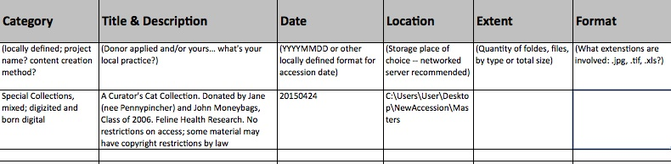
Notes:
DANIELLE
This is what the spreadsheet looks like with our example collection when we fill it in on our own. Notice that we have left the “Extent” and “Format” blank. We’ll show you a tool that will help fill in this information.

Slide 60
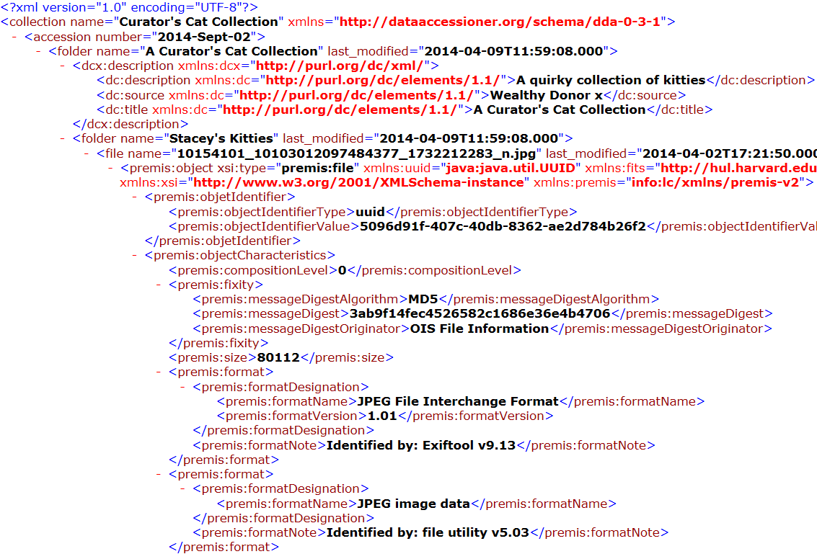
XML
Output
Basic descriptive and Dublin Core metadata that you created
Fixity/Checksum: MD5
Extracted metadata: tree hierarchy of your accession
(folder names, file names, last modified, size, and more!)
Identifying Information (Exiftool)
Identifying Information (file utility)
Notes:
DANIELLE
At end of product overview, mention that XML is a standard that many (all?) systems we tested can understand with little human intervention.
NotePad ++ is a free tool that can help you browse through and search the xml file, perform counts, etc.
But hold on! Isn’t there a better way to view this raw XML file? There IS! The developer of DA has developed a way to transform this raw XML into a nice report

Slide 61
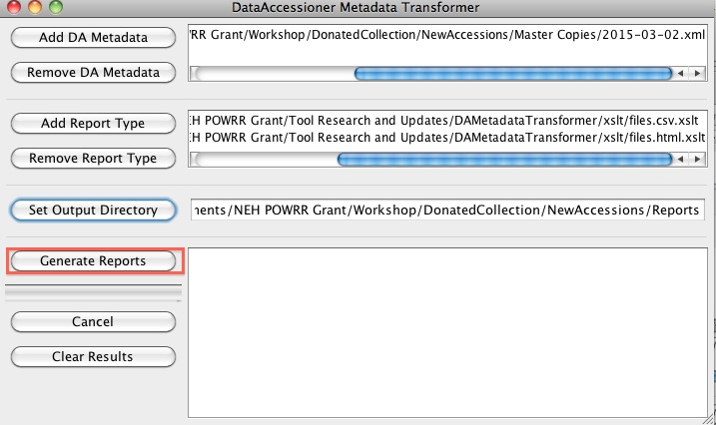
DataAccessioner: Metadata Transformer
Notes:
DANIELLE We would like to give a huge shout out to Seth Shaw, who not only updated Data Accesioner but added this wonderful reporting tool. Seth Shaw is amazing and nice. This reporting tool takes the raw XML and creates lovely reports that you can also attach to your collections (or eventually upload to a shiny system!)
CSV File – Gives you a high level view of the collection
HTML – allows you to see the the details in a more palliative view, seeing the metadata you added in DA.

Slide 62
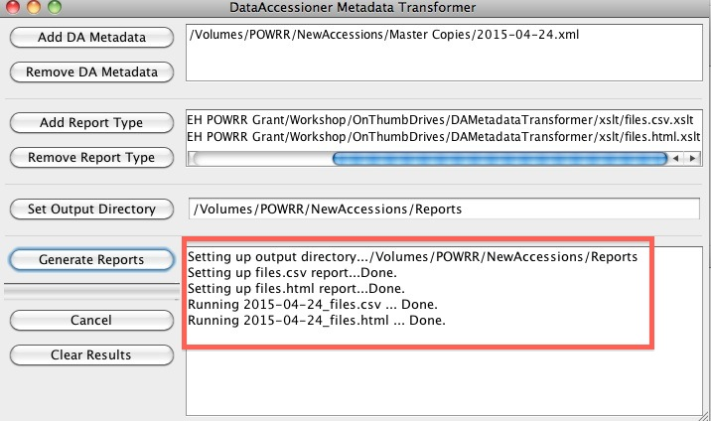
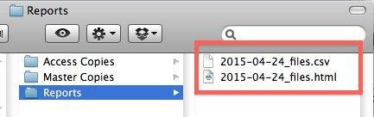
Once the reports have been generated, DA:MT will show the results.
In this case, two files were created: a CSV file and HTML file.
To view the files, navigate back to the “Reports” folder.
Notes:
DANIELLE

Slide 63
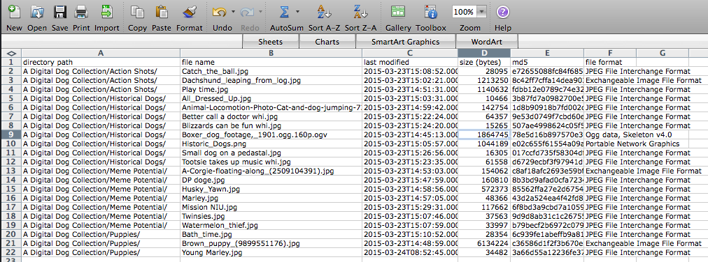
CSV FILE
Notes:
DANIELLE Much prettier than the raw XML, right?
**GO TO A LIVE VERSION TO DEMO THE HTML FILE. ONLY WORKS WITH CHROME**

Slide 64
Remember this?
Most tools and services only perform some of the functions in a digital curation lifecycle.
*Tools/Services in RED were tested in-depth by POWRR
Back-end * Storage * Preservation
Front-end * Processing
Archivematica
Curator’s Workbench
Data Accessioner
BitCurator
MetaArchive
DuraCloud
Amazon Glacier
Internet Archive
Preservica
Dspace Direct (uses DuraCloud)
ArchivesDIRECT
But there are very few services that will pretty much do it all.
Notes:
JAIME
Jaime note: To me, Front-end means the initial steps in the Dig Curation lifecycle, and not the “Access” part of things. Perhaps we can make it clearer by clarifying what it archivist/curator facing and what would be end-user facing (access/DIP/etc.)
We can also talk about which phases spit out SIP’s DIP’s and AIP’s and where those are used subsequently and by whom.
**ADD BITCURATOR INFO**

Slide 65

Front-end/Processing: Curator’s Workbench
Notes:
JAIME?
Briefly discuss this is a front end processing tool similar to DA, only is a MODS-based platform.

Slide 66
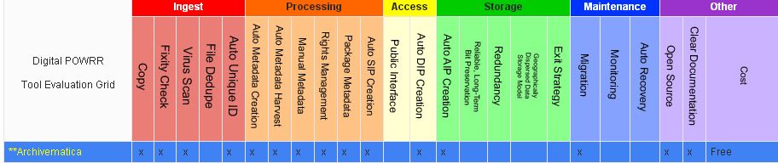
Front-end/Processing: Archivematica
Notes:
AAISHA

Slide 67
Front-end/Processing: Archivematica
Open source/free software
Requires IT support and administration (Virtual Machine, Ubuntu Server, etc.)
Microservices run by themselves
Shows all the steps for AIP, SIP, DIP
Capability to upload own metadata
Errors stop everything
Great Google users group support
Integrates with Content DM & DSpace
Bundled with ICA-AToM (archival content management system like ARCHON)
Hosted version now available
File transfers not intuitive
Slower processing, but that could be due to the fact that we are used to desktop-based applications
Notes:
AAISHA Hosted version now available – ArchivesDirect (will talk momentarily)

Slide 68
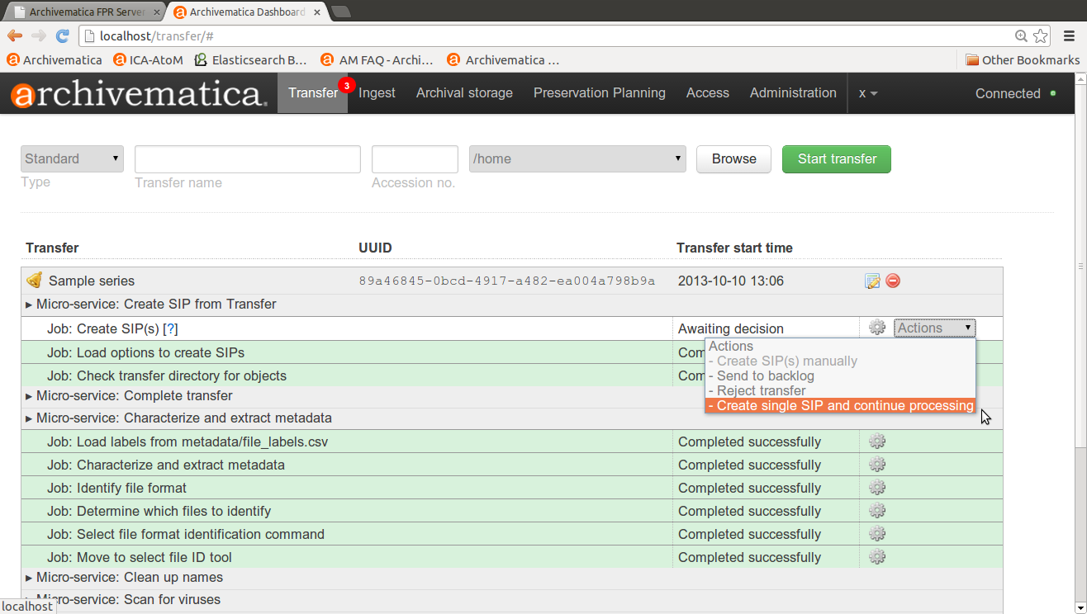
Archivematica: Transfer Collection
Notes:
AAISHA In Archivematica, Transfer is the process of transforming any set of digital objects and/or directories into a SIP.
In the Transfer tab of the Dashboard, the user moves digital objects from source directories accessible via the Storage Service into Archivematica.
Once uploaded to the dashboard, transfers run through several micro-services: UUID assignment; checksum verification (if checksums are present); package extraction (i.e. unzipping of zipped or otherwise packaged files); virus checking; indexing; format identification and validation; and metadata extraction.
At the end of transfer, the user creates a SIP from one or more standard transfer(s). Once this is done, the SIP is moved into ingest.

Slide 69
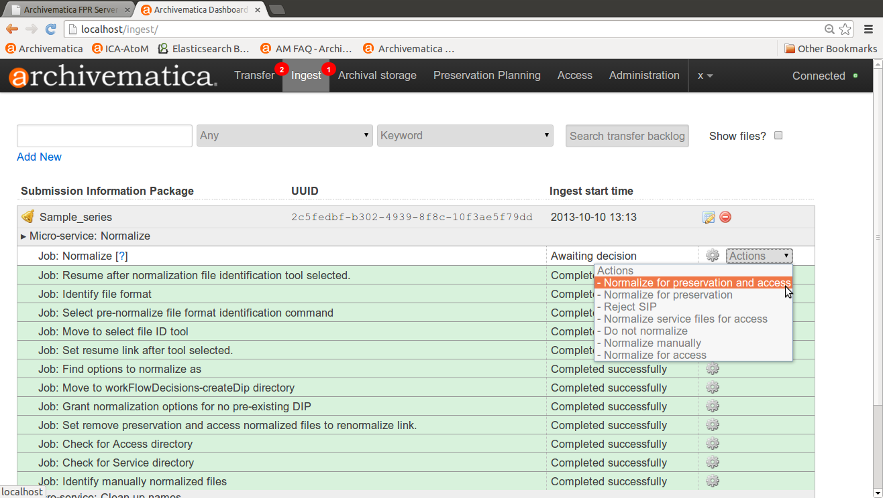
Archivematica: Normalization On Ingest
Notes:
AAISHA During ingest, digital objects are packaged into SIPs and run through several micro-services, including normalization, packaging into an AIP and generation of a DIP.
(this screenshot is of Normalization)

Slide 70
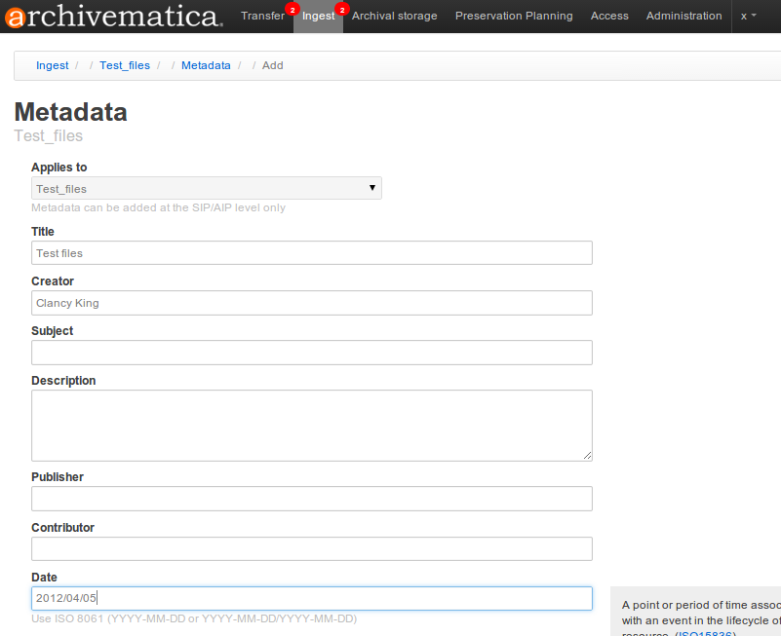
Archivematica: Add Metadata
Notes:
AAISHA

Slide 71
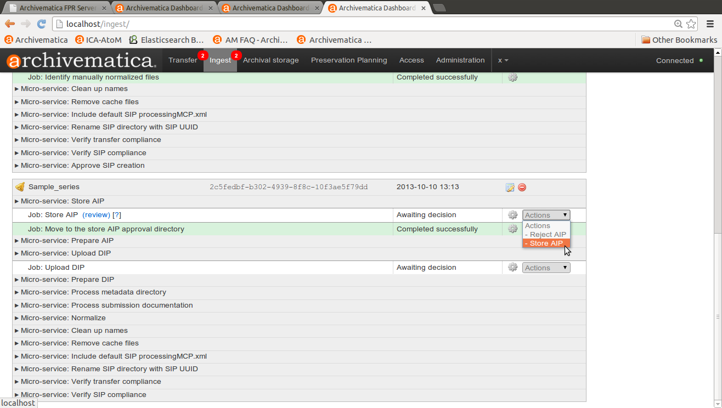
Archivematica: Add AIP to Storage
Notes:
AAISHA

Slide 72
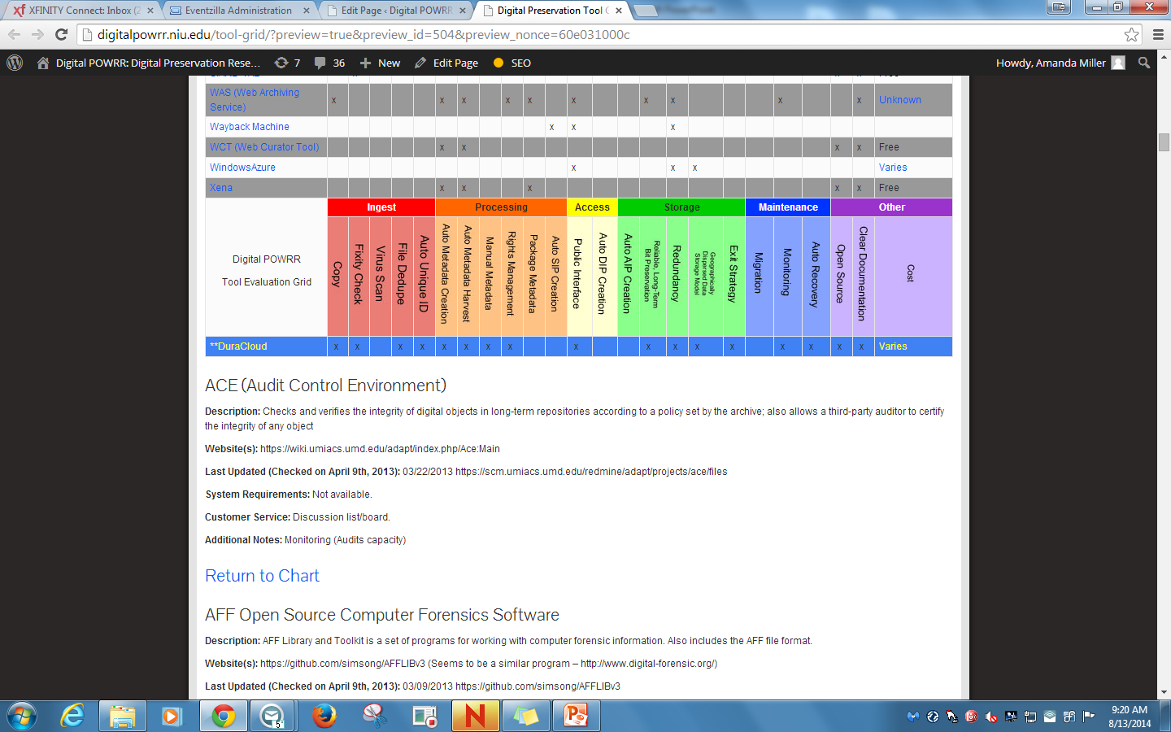
Back-end/Preservation: DuraCloud
Notes:
AAISHA

Slide 73
Back-end/Preservation: DuraCloud
Nonprofit; Open Pricing; Community buy-in
Cloud storage/preservation solution
Different storage provider options
Hosted service (requires little to no IT support on your end!)
Some microservices available (like health checks that verify checksums
Different options/methods for uploading content (bulk, single item, etc.)
Intuitive uploads and file management
Easy exit strategy
Easy integration with DSpace
New: Integrated with hosted version of Dspace
Media streaming based on Amazon’s Cloud service
Responsive customer service with very good documentation
Affordable; Scalable; Easy to get started
Notes:
AAISHA

Slide 74
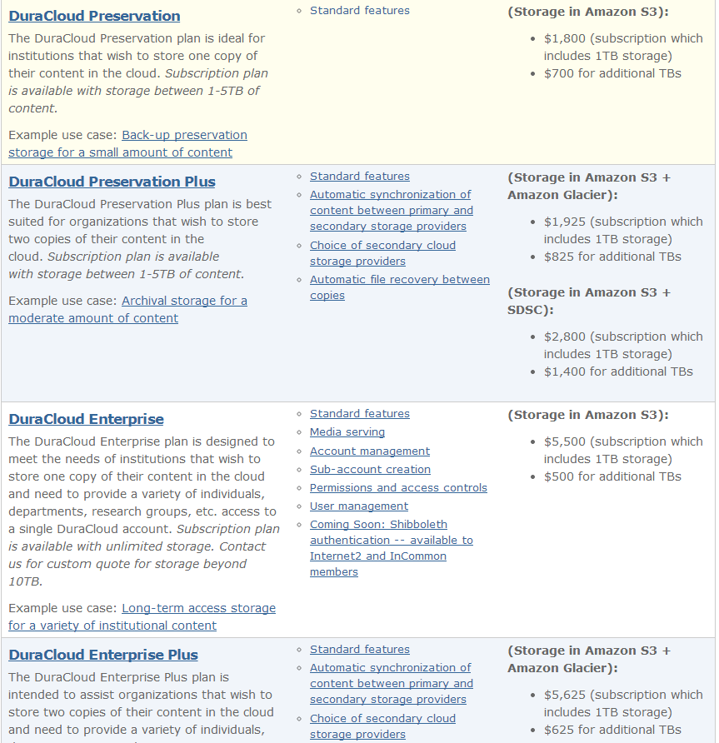
DuraCloud.org
Head to the website for…
Open Pricing
Free Trial
Lots of webinars and tutorials
Learn more about the new DSpace Direct… a hosted version of the DSpace Institutional Repository software that is integrated with DuraCloud for preservation
Notes:
AAISHA

Slide 75
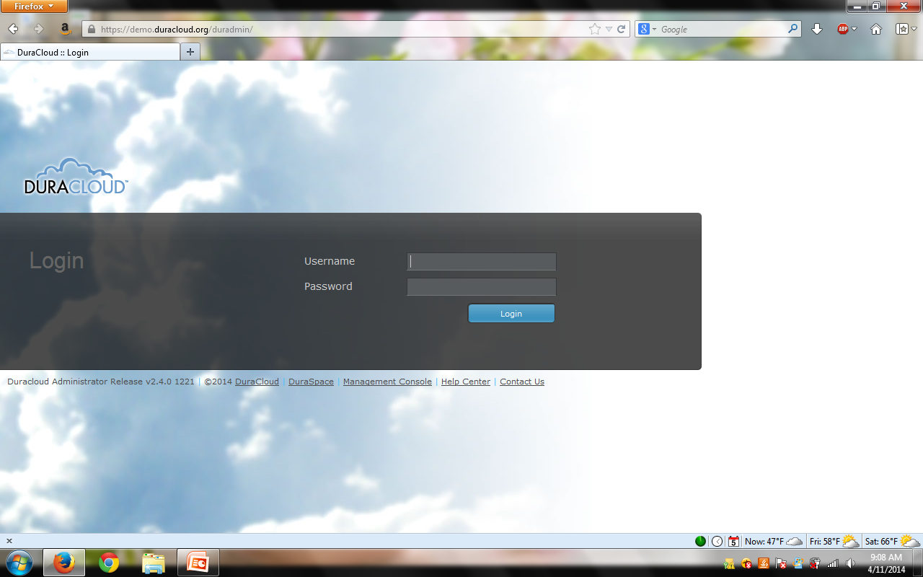
Notes:
AAISHA
This screen is depicting the DuraCloud log in screen to the web interface. Every customer receives a unique log in URL (i.e. http://organizationname.duracloud.org).

Slide 76
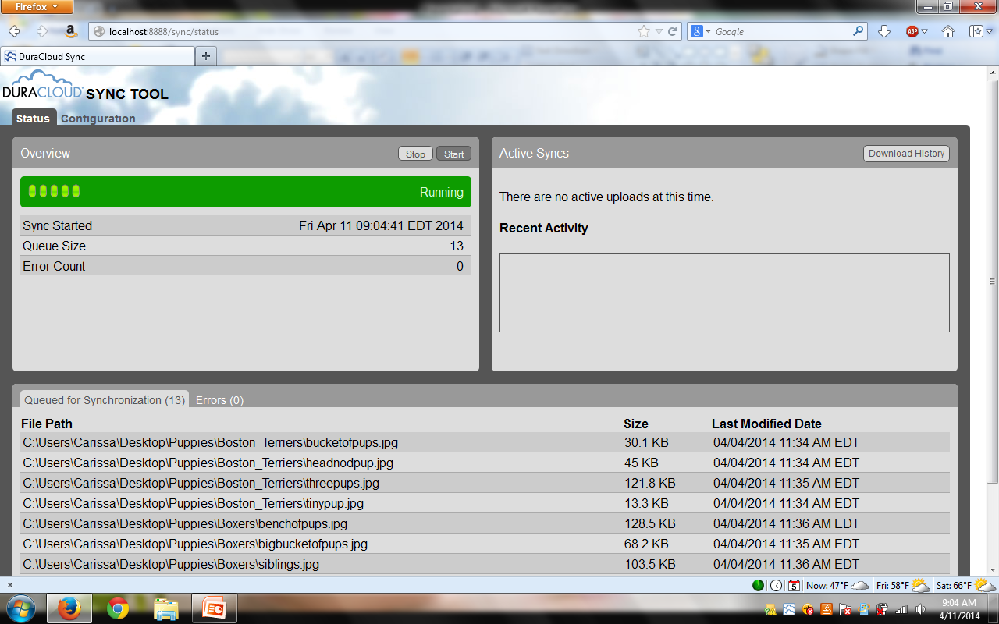
Notes:
AAISHA
This screen is depicting the DuraCloud synchronization tool. It is a software tool that you download and install on your local machine that walks you through a “wizard” in order to select the content you wish to upload to DuraCloud. As you can see in this screen, a directory called “Puppies” is actively being uploaded to DuraCloud.

Slide 77
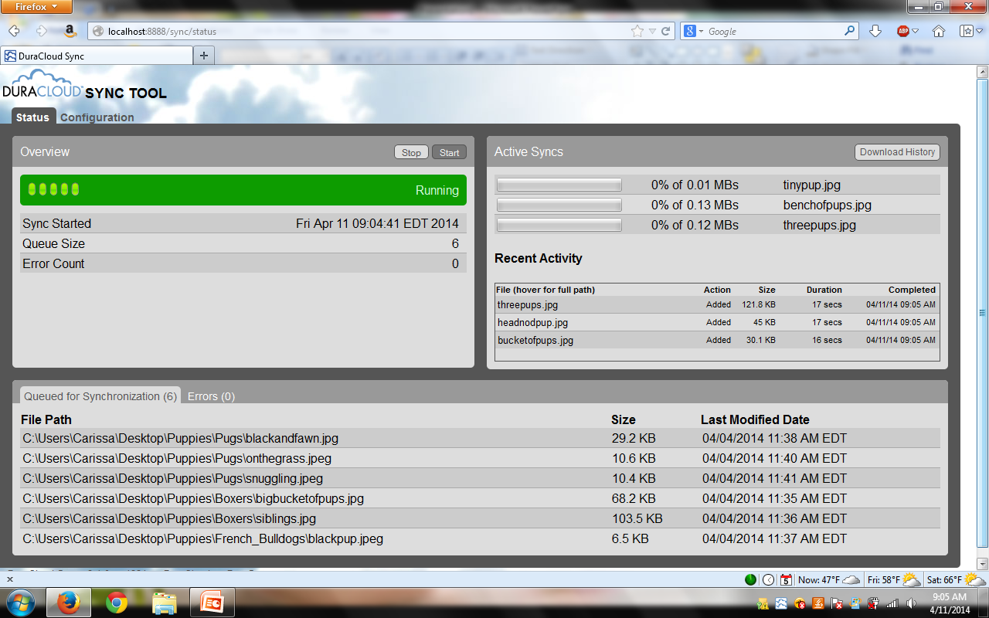
Notes:
AAISHA
This screen is depicting the DuraCloud synchronization tool in the process of uploading content to DuraCloud. In the right hand side of the screen you can see the individual files that are actively being transferred “synced” to DuraCloud, the most recent uploads are listed below that, and the remaining files left to upload in the “queue” are listed on the bottom of the screen.

Slide 78
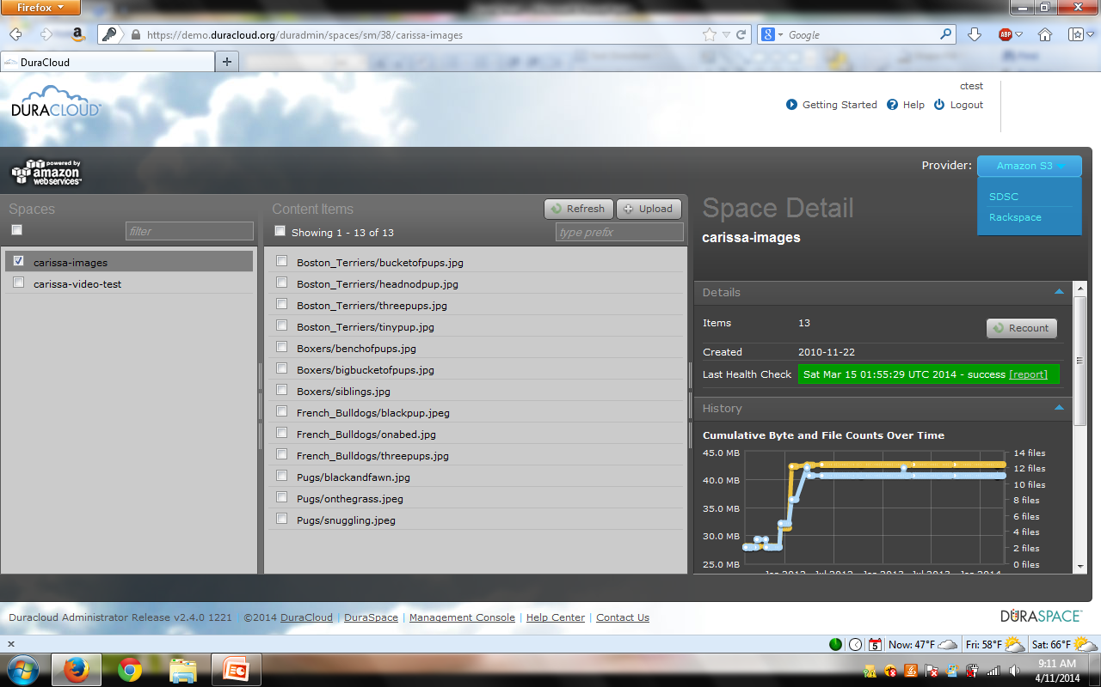


Notes:
AAISHA
This screen is depicting the DuraCloud web interface. On the left is the “Spaces” column (spaces are DuraCloud storage containers). In the center is the “Content Items” column that lists the content stored in the space that is selected. On the right is the “Detail” column that will show the detailed information for what you’ve selected. In this case it shows the details for the “carissa-images” space that is selected (highlighted in dark gray and checked). Space details captured include: total number of items stored, data the space was created, date the last health check was run over all content (as well as a link to download the health report), and history of content additions to the space over time. Additionally, this screen depicts the various storage providers that are available with this DuraCloud account. You can navigate to the various storage providers by simply hovering over the blue provider box and clicking on the sotrage provider name. The DuraCloud interface will update to show the content stored in the chosen storage provider. Note that the DuraCloud interface for all providers looks/functions exactly the same. The options for cloud storage providers within DuraCloud are: Amazon S3, San Diego Supercomputer Center cloud storage, Rackspace Cloudfiles, and Amazon Glacier.

Slide 79
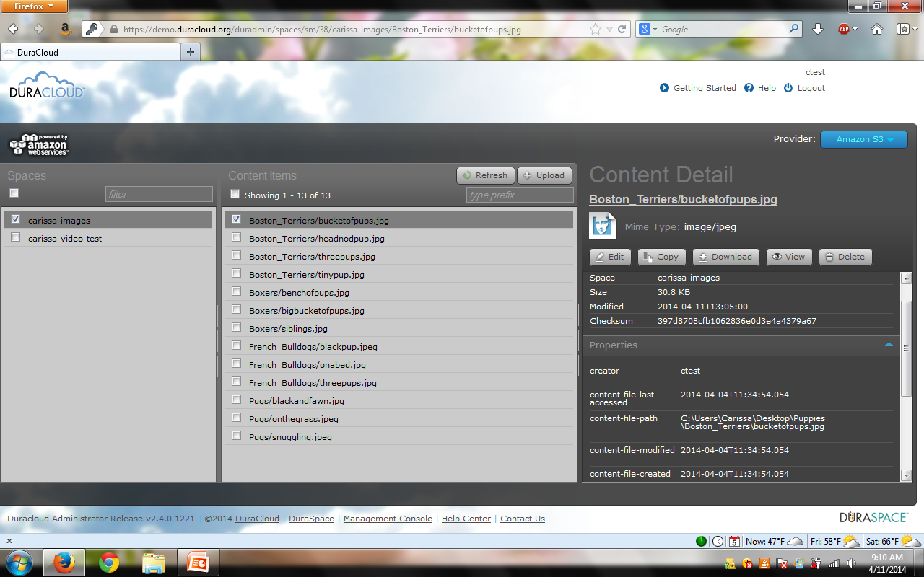
Notes:
AAISHA This screen is depicting the DuraCloud web interface. In this screen, the details for the “Boston_Terriers/bucketofpups.jpg” image that is selected (highlighted in dark gray and checked) are presented in the details column on the right. Content item details captured include: space where the item is stored, the item’s size, the item’s MD5 checksum value that DuraCloud calculated upon initial upload, the user who created/uploaded the content item, and the MAC time information for the item that was provided by the local file system upon first upload (MAC = modified, access, and change times for the file). Additionally, users can edit the mime type associated with the file, create a copy of the content item to store elsewhere in DuraCloud, download the content item, view the content item within the browser (if it’s an image file type), or delete the content item from DuraCloud entirely (this is a multi-verification step process).

Slide 80
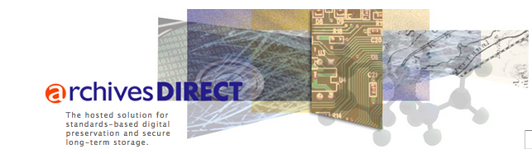
Archivematica (Front end)
+
DuraCloud (Back end)
=
Notes:
DANIELLE Archivematica and DuraCloud have teamed up to provide a hosted (web-based), “soup-to-nuts” solution that combines the front-end processing of Archivematica and the back-end preservation services of DuraCloud. This new solution is new as of February 2015, and so was not part of our original testing period.

Slide 81
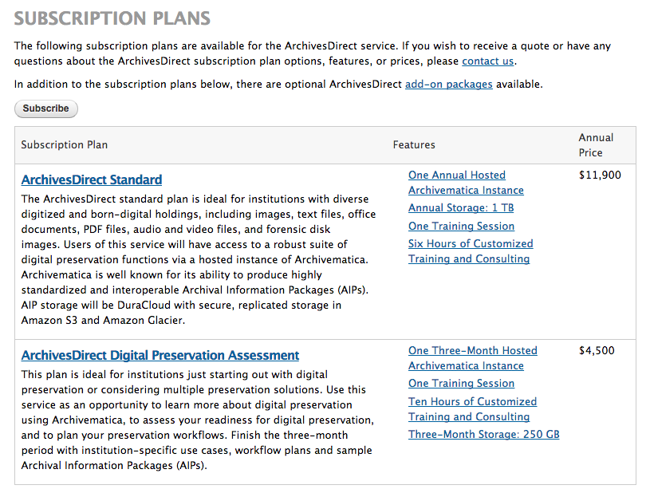
Notes:
DANIELLE Subscription plans available. They offer an add-on package for additional storage. For more than 1 TB of data, storage starts at $1000/TB/year (this is in addition to the standard plan). Ideal for institutions with large collections. For institutions with 10 TB or more, the price of storage can be reduced further (must contact them for quote).
**If there is time, we could watch the 3-minute overview video: https://www.youtube.com/watch?v=u7Ryyo2UWGA&feature=youtu.be

Slide 82
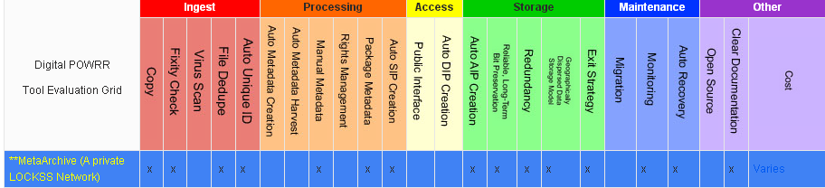
Back-end/Preservation: MetaArchive
Notes:
JAIME

Slide 83
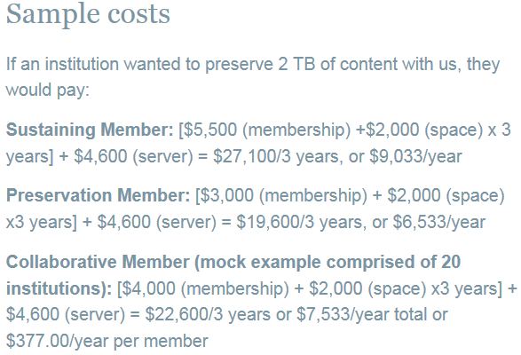
Back-end/Preservation: MetaArchive
Nonprofit; Open Pricing
Instant community in the Cooperative!
- All the cool kids are doing it!
Helpful and responsive customer service
Private LOCKSS network
Dark Archive
Requires dedicated IT administration
Most memberships require attending meetings
Assumes pre-processing work is done
Rules for minimum processing requirements (ie file naming conventions)
http://www.metaarchive.org/costs
What we tested
Notes:
JAIME Bagger + bad file name = failed on ingest to MA
We are creating the legal framework and business model for institutions wanting to band together to join as a Collaborative Membership!!
This is the model we tested…there are other options out there for membership (standalone memberships) screen shot of pricing One point about what we tested (collaborative) might mention that standalone and PLN versions require commitment to becoming host/server for a node.

Slide 84
Back-end/Preservation: MetaArchive
Very simplified version of how it works:
Collaborative Membership Model
1)
Partners prepare their content for preservation and package it.
→We used the BagIt specification, and Bagger helped us with this
MetaArchive
Tech
Help
2)
Lead Institution prepares a staging server, sets appropriate access protocols and assists Partners with technical help.
AIPs
Lead Institution
Staging Server
LOCKSS Server
3)
Partners FTP their AIP’s (Bags) to the staging server at the Lead Institution.
→ We used Filezilla
AIPs
via
FTP
Tech Help
4)
MetaArchive harvests the AIP’s from the Lead Institution's staging server and pushes it into their LOCKSS network.
Partner 1
Partner n
One other thing: The Lead Institution also has a dedicated server that runs the LOCKKS software, is hooked into the MetaArchive network of servers across the globe, and is actively preserving the content of other Members.
Partner 2
Notes:
JAIME

Slide 85
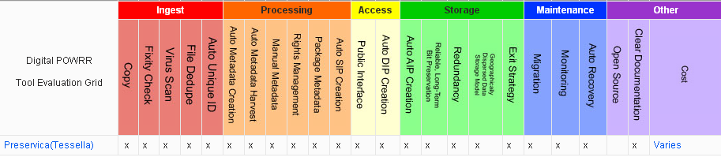
Front-end & Back-end: Preservica
Notes:
JAIME OR AAISHA

Slide 86
Front-end & Back-end: Preservica
All encompassing:
- Ingest
- Processing
- End-User Access
- Email management
- Preservation
- Migration
Aligned with OAIS reference model
Hosted Service (Requires little IT support on your end)
Very user friendly
Intuitive workflows
Ability to harvest via web crawls
Email archiving
Exit strategy available (batch export)
Solid customer support
Different training options available for institutions with smaller budgets
Currently uses only Amazon cloud storage
- new options forthcoming
Proprietary, vendor-based
Notes:
JAIME OR AAISHA
Do we want to note that this is not a replacement for an institutional repository? Or is it?

Slide 87
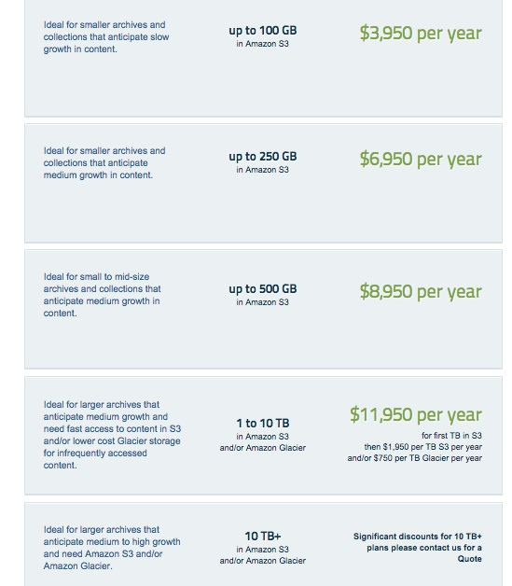

Notes:
JAIME OR AAISHA: pricing and features current as of April 9, 2015
New features include: Automated CONTENTdm, Microsoft SharePoint, and Outlook ingests; large file upload; one-day introductory training on regular webinars

Slide 88

Notes:
JAIME OR AAISHA

Slide 89

INGEST
Notes:
JAIME OR AAISHA

Slide 90

Notes:
JAIME OR AAISHA
If there is an error during the Ingest, the system will notify you and show an error message. You can view messages on the far right column.

Slide 91

Notes:
JAIME OR AAISHA Preservation Plan details – deciding what to put in the AIP.
Identify what is most at risk
Migrate files to a preservation-friendly format.

Slide 92

Notes:
JAIME OR AAISHA
PRESERVATIN - Migrate to AIP in Progress

Slide 93

Notes:
JAIME OR AAISHA
PRESERVATION - Storing to the AIP successful!

Slide 94

Notes:
JAIME OR AAISHA

Slide 95

Notes:
JAIME OR AAISHA Access view – you can actually SEE what was migrated!! You can also migrate and download documents to create access copies.

Slide 96

Notes:
JAIME OR AAISHA Access interface

Slide 97

Front-end & Back-end: Internet Archive
Notes:
DREW

Slide 98


Internet Archive
Only intended for materials in the public domain (available to everyone).
Geographically distributed copies.
No frills (and no charge!) service.
Handles books best, but can accommodate manuscripts, audio, video, and images.
Is especially suited for small (VERY small institutions with limited (or no) other alternatives.
Does offer a more traditional preservation product through its Archive-It service.
Notes:
DREW
Stores a preservation copy of the uploaded materials on 2 different continents
We have a tutorial for how to do this !!!!

Slide 99

Notes:
DREW

Slide 100
LUNCH

Slide 101
Next Steps:
Advocacy, Policy, and Potential Solution Models

Slide 102

Outside Your Office
Digital Preservation is not sustainable by just using a tool or selecting a service. Sustainability takes funding and people.
You cannot do this alone. You will need to talk to other people… because you are not the only boss of this.
Successful Digital Preservation programs take a team of people at multiple administrative levels.
Three-Legged Stool of Digital Preservation
Anne R. Kenney
Nancy McGovern
Digital Preservation Management Workshop
http://www.dpworkshop.org/
Notes:
AAISHA A fully implemented and viable preservation program addresses organizational issues, technological concerns, and funding questions, balancing them like a three-legged stool.
Organizational Infrastructure includes the policies, procedures, practices, people—the elements that any programmatic area needs to thrive, but specialized to address digital preservation requirements. It addresses this key development question:
What are the requirements and parameters for the organization's digital preservation program?
0101 Technological Infrastructure consists of the requisite equipment, software, hardware, a secure environment, and skills to establish and maintain the digital preservation program. It anticipates and responds wisely to changing technology. It addresses this key development question:
How will the organization meet defined digital preservation requirements?
$$$$ Resources Framework addresses the requisite startup, ongoing, and contingency funding to enable and sustain the digital preservation program. It addresses this key development question:
What resources will it take to develop and maintain the organization’s digital preservation program?

Slide 103
Sometimes We Get Lucky
Open Access to Research Articles Act (2013)
Requires state funded institutions in IL to provide open access to articles produced there; includes digital preservation in remit.

Slide 104
Campus Advocacy, Round 2
Digital preservation is included in the OARAA. We are legally required to address it. (Impetus)
Digitization (and ContentDM, and the internet…) is NOT digital preservation. (Education for content creators/stakeholders)
Digital preservation is mission critical institutionally and requires funding as such. (Risk management)
Digital preservation is affordable with sufficient planning. (Budgeting)

Slide 105
Source
What can we do?

Slide 106

Assemble Your Team!
Source: Den of Geek
Notes:
AAISHA

Slide 107

Captain America: Man Out of Time
Curators, Archivists, Librarians with paper-centric training
The universe changed around us
Learning curve? “Translation” sometimes needed

Slide 108

Iron Man: The Money
Money lives here
Likes shiny new tech in sound bites
Get to the point
Often upper-level administration
Source: SuperheroHype

Slide 109

Pepper Potts: The Expediter
Has more power than she lets on
Often key to getting involvement from Iron Man
Mid-level admin?
Source: AvengersWikia

Slide 110

The Hulk: The Muscle
Digital Humanists/ Faculty/ Content creators / donors
Their work is at risk
Often prefer to be left alone
You wouldn’t like him when he’s angry
Source: Slashfilm

Slide 111

Thor: The Champion
May be project director, digital archivist, etc.
Skills/knowledge from out of this world
Much is expected
Source: Slashfilms

Slide 112

Black Widow & Hawkeye: IT Support
Software & Coding
Networks
Specific skill sets, but hugely Important to project success
Source: Slashfilms

Slide 113

Scarlet Witch: Metadata Magician
Often more behind the scenes than not
Power when you need it
You really miss her when she’s not there
Source: Slashfilms

Slide 114

Agent Coulson: The Motivator
Communication / Advocacy skills
Helps keep goals clear
Not always the leader, but could be
Source: Zap2it

Slide 115
Next Steps: Advocacy
Advocacy is valuable because you’re educating people about why digital preservation is also THEIR problem.
- Our one-pagers may help you frame why digital preservation is important to different jobs/function.
- The risks of doing nothing are a lot greater than they may think.
Good policies incorporate multiple viewpoints.
Other people at your institutions will bring up issues – and possible solutions – you may have missed.
You will discover many things that you don’t directly control that still directly affect your work. This will lead you to more people to add to your team.
Notes:
JAIME Have them get out one pagers here!

Slide 116
Source
What can we do?

Slide 117
Next Steps: Towards a Policy
You have started assembling your team….now what?
We found a gap analysis really helpful:
  Where are you now?
  Where would you ideally like to be?
  What is keeping your institution from moving in that direction?
  What are some interim steps you can take to move in the right direction?
Notes:
JAIME

Slide 118
We also found that Gap Analyses can be challenging…
Next Steps: Towards a Policy
  Be brutally honest. It’s the only way to move forward.
  Look closely at risk: What is the cost of doing nothing?
  Documenting what you know will tell you what you don’t know.
  Feel free to look at our case studies and see how it worked. Our wiki has the case studies of all 5 of the POWRR partner institutions.
  http://powrr-wiki.lib.niu.edu/index.php/Main_Page
Notes:
JAIME
Jaime: Identifying what is it risk (inventory), why it is at risk (one-pagers), and what the loss would mean to your institution will make an incredibly compelling case to your leaders (aka the holders of the checkbook!)

Slide 119
Next Steps: Towards a Policy
Policy is where the ideal leads to actual workflows within your organization.
We’ve collected links to resources on our website for getting started.
http://digitalpowrr.niu.edu/digital-preservation-101/
Iterative is TOTALLY OKAY.
Begin with how you would LIKE your workflow to run: tool selection may come out of that.
Does it work with your already existing policies?
It’s better to have a draft policy ready if resources show up than random resources with no policy.
DOCUMENT what you do….future you will be deeply grateful.
Notes:
JAIME

Slide 120
Next Steps: Potential Solution Models
Notes:
JAIME

Slide 121
Source
What can we do?

Slide 122
How to Decide? Results May Vary…
Things to consider:
How many staff members will be actively engaged in the digital curation lifecycle? Are they tech-savvy?
How robust and supportive is your technical/systems group? Do you even have one? How about some developers/programmers…have any of those on staff?
Is your institution already using archival management software or an Institutional Repository (like ARCHON/ArchivesSpace, BePress, Fedora etc.)? You’ll want to select tools/services that work well with what you have.
Do you have digital collections unique to your institution that are irreplaceable? Consider organizing collections along the lines of those that warrant more robust preservation services than others. For example:
1 TB (High Value) → MetaArchive (gold standard)
3 TB (Medium Value) → Amazon Glacier (cheapest storage with fixity checking)
Rest (Replaceable) → Tape Drive Backups
In other words: One tool/service will not be your only solution.
Notes:
DANIELLE

Slide 123
How to Decide? Results May Vary…
Remember: Smaller institutions with less resources may also have unique advantages like….
You only need to convince the person one level above you to get what you need.
It doesn’t take years to set up an account with something like DuraCloud.
Want to install a simple open source tool? Go for it!
Less red tape for getting things done
Fewer levels to push requests for additional resources through
Self-administered workstations (aka no IT administrative lock downs)
Personnel-heavy operating model (usually has smaller cash flow)
Higher cash flows and less data (like small, private institution)
This is ideal for running a *free* robust tool that requires a developer and server administrator like Archivematica.
You can purchase a reasonably-priced, hosted soup-to-nuts solution.
Notes:
DANIELLE You can have a lot of archivists and no one tech-savvy. That could be a problem
NOTE: maybe mention that Glacier is available as standalone storage and also a back-end option with X products that we tested?

Slide 124

Next Steps: Potential Solution Models
POWRR White Paper available at:
http://commons.lib.niu.edu/handle/10843/13610
Notes:
DANIELLE

Slide 125
Source
What can we do?

Slide 126
Group Activity: 3-3-3 Action Plan
Create a list of job titles/roles in an organization that could play a part in some aspect of digital preservation
Notes:
AAISHA Give them a couple of minutes to brainstorm some on their own (or in small groups based on institution type…)
Start white-boarding the roles.

Slide 127
3-3-3 Action Plan: Build Your Team
Now let’s move from roles to people….
On your 3-3-3 Action Plan handout, list 3 individuals at your institution in these roles that you already have a working relationship with, or would like to.
Which of these folks are you willing to contact in the next 2 weeks?
…in the following month?
…in the following 3 months?
After bringing these colleagues on board, what are 3 concrete, small steps that you can take together to move your burgeoning DP program forward?
Conversations/Meetings
Inventory what you already have
Enhance the metadata of the records you already have
Look at how current policies address digital materials (ex. collection development)
Download DA and play with it some more!
Tool investigation: Dig a little deeper on tools that piqued your interest today
Look at other institutions’ DP policies with an eye to crafting your own
Engage in some outreach/education activities…host a Brown Bag!
- Read the POWRR white paper
Notes:
AAISHA : I can imagine that some people might not “already have a working relationship” with people in the roles listed. Maybe add this as a point for emphasis.
Think of it as moving even one square to the right on the NDSA Levels of Preservation grid

Slide 128
Now Let’s Assess...
How will you know if your 3 activities succeeded?
Added people to team?
Number of people newly educated?
Number of items added to inventory?
Number of tools investigated?
Number of DP policies looked at?
Revised standing policies?
Notes:
AAISHA

Slide 129
Wrapping Up
Our Final Thoughts & Your Questions
I survived the POWRR workshop! Now what?
https://digitalPOWRR.niu.edu/survived-powrr-wkshp/
We’re here to help. Seriously.
YOU CAN DO THIS. Really. But not alone. So bring some friends.
“If you want to go fast…go alone. If you want to go far…go together.” — African Proverb
Remember: Baby steps still move you forward!
Notes:
DANIELLE

Slide 130
Source
What can we do?

Slide 131

We can be positively stubborn. And win. Eventually.

Slide 132

(That’s French for “LET’S GO!”)

Slide 133
POWRR Project Team Members
Contact us…we are here to help!
Northern Illinois University
*Lynne M. Thomas Curator, RBSC
lmthomas@niu.edu 815.753.0255
Drew VandeCreek Director Digital drew@niu.edu Scholarship
815.753.7179
Jaime Schumacher Scholarly Communications jschumacher@niu.edu Librarian
815.753.0576
Danielle Spalenka Digital POWRR Director
powrr@niu.edu
Stacey Erdman Digital Collections Curator
serdman@niu.edu 815.753.1004
Chicago State University
Aaisha Haykal University Archivist
anhaykal@gmail.com
Martin Kong Systems Librarian
martinkong2@gmail.com
Illinois State University
Patrice-Andre Prud’homme Digital Collections Head
ppprudh@ilstu.edu 309.438.5385
Illinois Wesleyan University
Meg Miner University Archivist
mminer@iwu.edu 309.556.1538
Western Illinois University
Jeff Hancks Director, Archives and
jl-hancks@wiu.edu Special Collections
309.298.2717
* Presented today
Notes:
LYNNE

