Slide 1
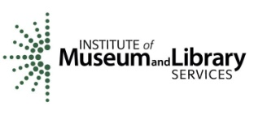
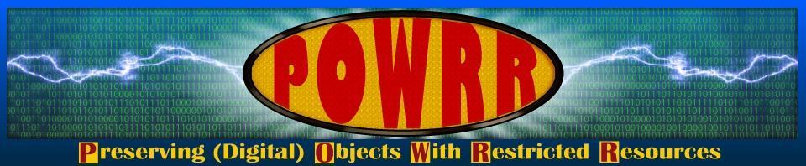
Digital POWRR
Preserving Digital Objects with Restricted Resources
Meg Miner, University Archivist, Illinois Wesleyan University
National Archives Conference for Fraternities and Sororities, June 13, 2014
http://digitalpowrr.niu.edu/
Notes:
Good morning, it’s great to be here today. What you should know about me that was not covered in the intro is that I’m a book-and-paper-lovin’ librarian. I’ve spent three years working on the subject of digital preservation intensively, and I really only ever heard about three years before that. In today’s presentation, I aim to share some of the practical steps you can take to secure the digital objects being created by members of your organizations.
You are a different audience from the people we thought needed to know about digital preservation. My group has been doing full day workshops for librarians and archivists. What we’ve discovered during our project is that everyone needs to know about DP. I hope the information I have for you today will be helpful.
What’s changed for people like you and me—people who preserve cultural heritage—is that we don’t have the luxury of waiting 30 years before deciding how to preserve digital objects. I brought this scrap book from early 20th century to help fix this idea in your minds. Someone from my Alumni Office dropped it off in the archives last summer and it’s doing pretty well after 100 years…that’s not going to be true for a digital scrapbook. The challenge of our kind of work today is to make sure we provide the digital equivalent of this to our future selves.
But let’s start out by spending a few minutes figuring out what everybody in the room knows. I’m going to have you do a little icebreaker right now—I understand you all may not know each other and the first lesson of DP is that you can’t walk this road alone! The question is “When I say “digital preservation” what comes to mind?”
I want the people in the first and third rows to turn around and create a discussion group with the two tables behind you. Take a minute or two to talk with the people at your four-table group, then you will share out to all of us what your table came up with. The person who traveled furthest to be here will be the spokes for your table, and the closest person will jot down all the ideas you come up with.
What is digital preservation? Anyone want to volunteer a definition or example? I will type out the answers you all come up with.
“Digital preservation is best thought of as an incremental, ongoing, and ever-shifting set of actions, reactions, workflows, and policies.” (NDSA definition) We’ll be talking about some of these workflows and actions, but it’s a good thing to keep in mind that there’s not really one answer to the question and also that one person’s answer may not be the same as another’s.

Slide 2
Who we are….and how we got here….
Defining Moments → Found Some Friends
Applied for an Implementation Grant → Received a “Figure It Out” Grant
The Digital POWRR Team: Proud to be works-in-progress
Notes:
I represent one of the five institutions that received a federal grant in 2011. I got involved because my school had been digitizing objects and then I started to hear about the need to preserve them. Until that point I didn’t know that digital objects would need preserving. We’d also subscribed to a product that I was told would preserve our objects but the product’s definition of “preservation” was different from others. The members of my grant group all have similar stories.
We started out thinking we could identify one solution and buy it. IMLS said we couldn’t but recognized the importance of DP for small organizations—we all collect and create unique objects of cultural heritage!—and they asked us to explore the problems and figure out what might work for people like us.

Slide 3
Assumptions in the Digital Age
Storage is cheap and everywhere!
Is the content secure/accessible? How? By whom?
If it is digital it will always be available!
Will it be useable? If software changes or files decay how will we know what is gone before it is too late?
Notes:
Everyone has an idea of what digital preservation means. Most people assume because something is digital it IS preserved. We who are charged with caring for historical records need to push back a little on these central assumptions especially because at some point we all have to convince the people who fund our operations to spend money on this.
These are widespread beliefs! We see digital objects on the screen all day…it’s easy to think they exist, they are stable and they’ll always be there. But that’s not really the case. It’s our job, our duty, to care for these objects as much as we can within the boundaries of our resources.
So I’m going to take you through some examples that you can use with others. Takeaway concepts for today are #1 storage is not preservation and #2 different digital formats have different preservation challenges. The punch line for this talk is: ONE SOLUTION WILL NOT WORK FOR ALL.

Slide 4
Storage
Storage options are cheap and everywhere!

Slide 5
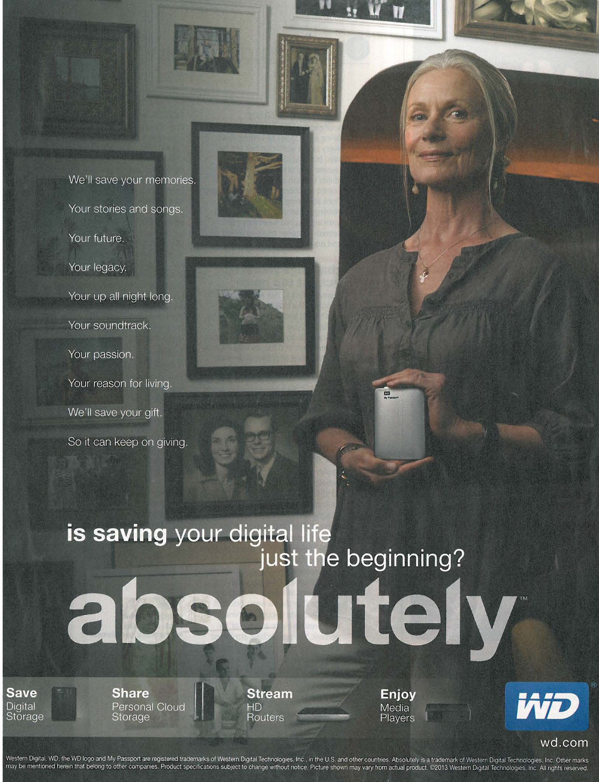
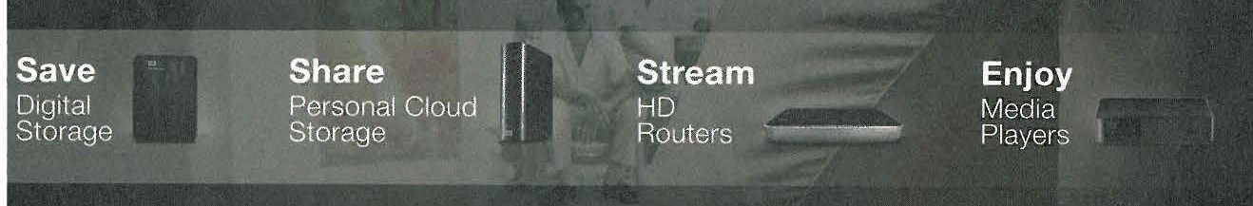
Storage
≠
Preservation
Notes:
These kinds of ads pop up everywhere. We’ll sell you a box and your legacy will be secure. It’s a simple statement to make and one that most administrators in my experience think will solve the problem. Of course I am going to tell you the solution isn’t that clear.

Slide 6
Storage (cont’d)
Storage options are cheap and everywhere!
But human intervention is not (and we are so busy that it is easy to put off)
Files need naming, tagging, organizing AKA metadata
Do your backed up versions all match?
Do you spend time synching devices? How much?
Notes:
Human intervention is needed, so no matter how cheap the storage, making the objects we store meaningful and usable over time will never be cheap!

Slide 7
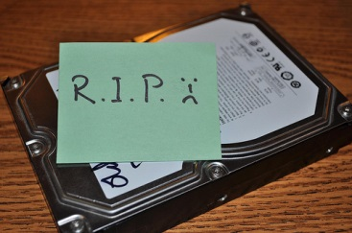
Storage (cont’d)
Don’t forget: all drives fail eventually
“Do you have a back-up plan?” by John K
http://www.flickr.com/photos/johnkay/5200871042/
Notes:
Expected lifespan of an external hard drive is five years.

Slide 8
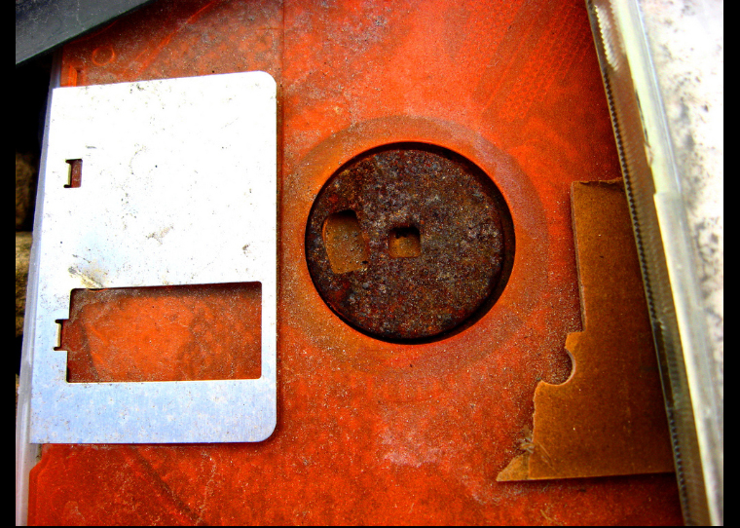
Storage (cont’d)
Media needs to be replaced every five years (aka migration)
“Bit Rot” by The Joy of the Mundane
http://www.flickr.com/photos/mundane_joy/2316921309/

Slide 9
Storage (cont’d)
Storage options are cheap and everywhere!
But human intervention is not (and we are so busy that it is easy to put off)
Do your backed up versions all match?
Remember: you get what you pay for with physical storage and in the Cloud!

Slide 10
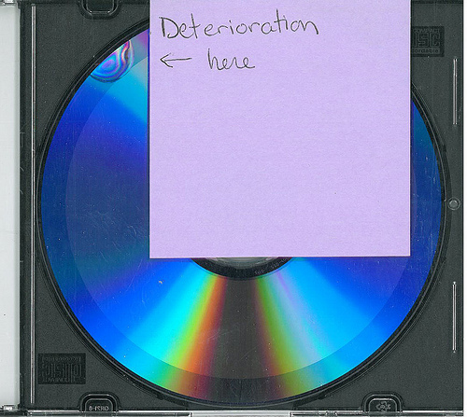
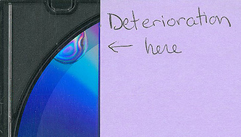
Storage (cont’d)
Backups on cheap and/or fragile media
“Data deterioration” by Univ.of VA Library, Preservation Services
http://www.flickr.com/photos/uvalibpreservation/8033085992/
Notes:
CDs and DVDs are subject to random scratches and rendered unusable. This image shows some of the compressed layers used to make a CD coming apart.
From http://www.archives.gov/records-mgmt/initiatives/temp-opmedia-faq.html
CD/DVD experiential life expectancy is 2 to 5 years even though published life expectancies are often cited as 10 years, 25 years, or longer. However, a variety of factors discussed in the sources cited in FAQ 15, below, may result in a much shorter life span for CDs/DVDs. Life expectancies are statistically based; any specific medium may experience a critical failure before its life expectancy is reached. Additionally, the quality of your storage environment may increase or decrease the life expectancy of the media. We recommend testing your media at least every two years to assure your records are still readable.

Slide 11
Storage (cont’d)
Cloud providers may not = stable, consistent access
What security measures do they promise?
Do they back up anywhere? How will you know?
Do they offer an exit strategy if they go out of business?
If the person who set up the account dies, who has access?
Notes:
Ads for cloud providers are everywhere, too. This is another favorite of administrators, especially with free versions of things like DropBox. We do have to ask ourselves why a company should give us something for free. Are we being mined for their data collection purposes? What loyalty do they owe us? I’d say if you pay nothing, expect nothing!

Slide 12
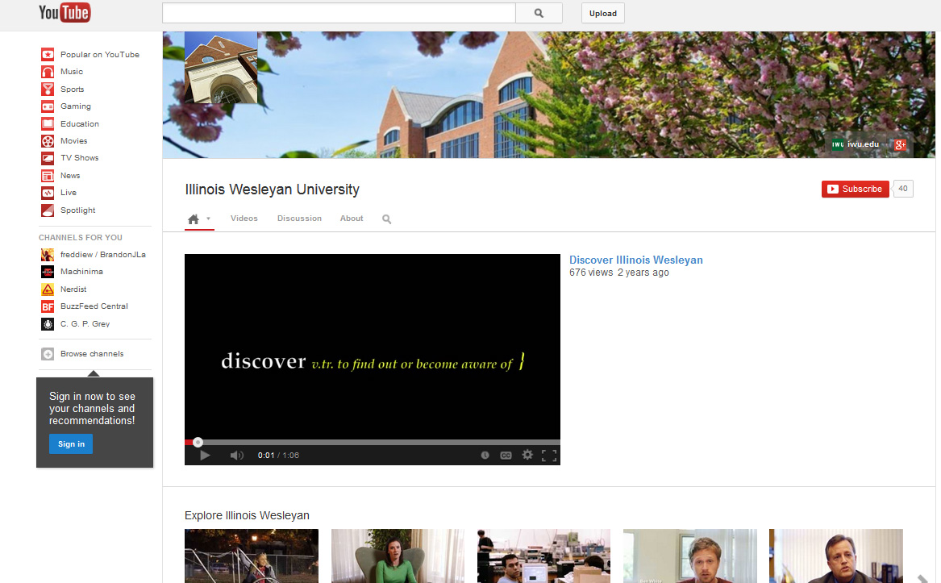
Served ≠ preserved
Notes:
The perception of stability in cloud storage is an issue that needs to be called out a little more before we move on. Making something accessible in a web-hosting product is quite common. But access online isn’t preservation. What guarantees do we get from YouTube or Vimeo to protect our stuff? We can’t rely on third-party providers to have our interests at heart. Serving content is a crucial part of serving our communities well, but it is not preservation!
Preservation is separate from storage and access.

Slide 13

Clarification: Preservation vs. Access
Long term access (Preservation)
Short term access
Purpose: ensure long-term access
Focus: current & future users
Relies on proven (reliable) technologies to preserve digital objects across generations of technology
Accumulates metadata over the life cycle to trace preserved content
Preservation systems create new versions of digital objects for access to deliver as needs change over time
Purpose: provide content to users now
Focus: current
Relies on cutting edge technologies to provide best and fastest access at a point in time
Selects metadata needed to use and understand content
Access systems deliver objects with user-oriented services
Notes:
In order to hone in on Access vs Preservation, this table from the Library of Congress may help.
While there are ways to do both high-impact preservation and access together, they are expensive. As a colleagues says, “Access is currently gravy.”

Slide 14
Two steps towards preservation
Making back up copies of digital objects vs.
Making back up copies of digital objects and storing them in different places
The minimum recommendation: 2 copies
Geographic distance = more protection
A Web site and networked servers that are backed up to another city.
Specialized storage sites (details to come!)

Slide 15
Full digital preservation
Decide which digital objects need to be saved, describe them, backing up (duplicate) in geographically distant places, and monitor the digital files for deterioration (the bit rot factor—more to come!).
4Ds and 1M Decision making + Description + Duplication + Distance + Monitoring = Digital Preservation
Notes:
We can think of full DP as a mathematical equation of 4Ds and 1 M. The “deciding” part is the most critical thing and it is a concept that, as archivists for our organizations, we’re already familiar with. We have collection development policies and inventories for our analog holdings. Each organization needs to assess its digital content and determine what will drive the level of preservation our objects receive. You can do one-size-fits all and just preserve everything to the maximum level (4Ds + 1M) but it will be more costly. A cost-effective approach over time requires us to scrutinize our digital collections a little more closely.

Slide 16
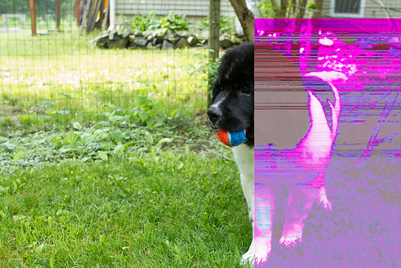
Files become corrupted or degrade (aka, bit rot)
Notes:
We don’t think of deterioration for digital objects but it can happen, too. There is a form of digital deterioration called “bit rot.” That is, randomly dropped 1s and 0s that you won’t be able to predict or even notice until you open a file and see something like this…or maybe can’t even open a file at all. This image represents the phenomenon, and the truth is we won’t be able to tell by our physical senses that it’s happened until it’s too late. Full digital preservation systems help us mitigate this problem. I’ll talk more about those later.
What puts e-records at risk? I want to introduce the concept of “inherent vice” as theme to center around. Inherent vice means that there is some attribute that is inherently part of materials we hold that can cause their demise.
Even if you don’t know the term, you will probably have seen evidence of it: crumbling, yellow/brown paper is the most obvious (acid in wood pulp). There are also rubber bands that dry out and become hard and taped media (like reel-to-reel recordings) that can become brittle or start smelling like vinegar.

Slide 17
Digital inherent vices
Bit Rot
Proprietary formats
Software
Hardware dependencies
Practices of people who create these objects!
Notes:
Bit rot was the first DP concept that made me worry about the digital objects in my care, but there are other, more prevalent e-records vices that we can be aware of AND prepare for with fairly little effort. These vices are proprietary formats and the software needed to read a digital object and even the hardware that has to be used to play certain media types (show historical formats like beta tapes and an assortment of floppies).
And then there’s a “vice” represented by things that are inherent in the way people create and keep digital objects that you might need: storage you can’t access (hard drives, email accounts, social media, iPhones) and online postings of records that get updated—that come and go without your knowledge.

Slide 18
Solution in Practice AKA Good Enough DP for real people!!
Our take on what you need to consider when thinking about your digital stuff…..
Getting it
And a few other odds & ends…
Letting people use it …or not!
Understanding it
&
Documenting it
Taking care of it
Notes:
This is what the whole spectrum of preservation looks like. In many ways it’s pretty similar to what we do with analog content. My group, the Digital POWRR folks, charted out where different products fit on this spectrum in order to visualize how to move from the basic steps to a complete preservation system, including one that analyzes all the hidden 1s and 0s health of our objects.

Slide 19
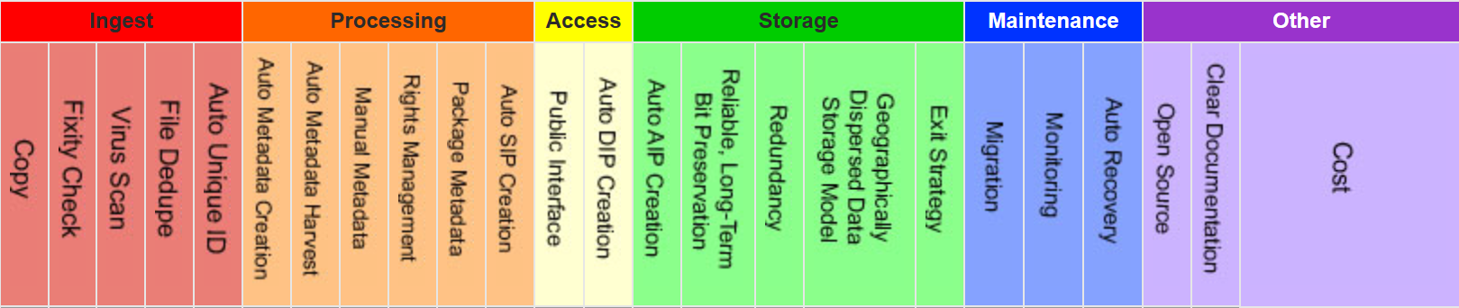
Our take on some things that need to happen or be considered along the way to this “Digital Preservation” thing….
The live site is at http://digitalpowrr.niu.edu/tool-grid
Notes:
See handout for take-home copy of terms and definitions.
There are more details here than we will go into today, but what I am emphasizing here is what we started with: digital preservation is more then storage. And when you talk to sales people or start evaluating the ways you might preserve your digital collections, these attributes are part of the complexity you will need to think through.
What’s not on this screen or in your handout are all the products you can find out about on our site: we looked at 60 tools and services and charted them out against this grid of attributes. We created this grid so that people have an at-a-glance resource. We chose six of the 60 to test in-depth. A few of the products we tested will probably work for most of the people here today. I’ll bring those up shortly.
CAVEAT: Time Sensitive. Software changes quickly. Like, REALLY QUICKLY. Reference COPTR (Community owned preservation tool registry)

Slide 20
Activity Time! 5 Minutes
1) What content do you collect that increasingly only comes in digital form?
-- Example: Pictures, news items, etc.
2) How are you receiving it?
-- Example: Email, flashdrive, website?
3) What problems are you encountering that are new to you?
Notes:
Let’s get you all talking to each other again. Take five minutes this time to collect some concrete things that can help with the next part of the presentation. At your tables, the people who didn’t write notes or speak for the table last time will take a turn. So designate a new scribe and a spokesperson and consider these questions.
If not raised, ask “What about posts on websites? Any social media content interest you?” How can we capture or secure those things?

Slide 21
Format examples
Word documents or other text-based material: we may decide we only need to print the documents and store as we used to.
A/V content: we need more information. Was the object created in a format you can monitor for obsolescence?
Notes:
The tipping point for me is whether or not it’s useful to keep text-based objects electronic. Most of the time my definition of useful means “searchable” but we might also equate useful with something you know is requested often or needs to be easy to share.
For A/V content, we need more information and that leads us back to that concept of inherent vice.
Your staffing level or budget will influence the decisions: more staff, less money might make self-monitoring necessary;
more money, fewer staff might mean you can outsource to a preservation service.
{If data comes up: Keep any printed product or output from the original creation purpose. Then try reducing to .csv or .txt for storage. Can be exported back into databases and spreadsheets and not tied to proprietary forms.}

Slide 22
Saving originals is good practice but…
Consider “normalizing” content, too!
Copy HTML to Word or ODF, PDF or PDF/A
Transfer audio/visual content from CD/DVD and save files locally with an open multimedia player like VLC http://videolan.org
Check out tips for media and social media at http://digitalpowrr.niu.edu/digital-preservation-101 /personal-preservation/
Notes:
Unless you subscribe to a web-harvesting service, you will have to capture text-based content like blogs and make them into Word or PDF for long term preservation.
OpenDocumentFormat
There are many issues to consider for A/V content but long-term it will be best to keep the original media but also make a copy in an open or widely adopted format that can be stored on a server or drive.
With as unstable and prone to obsolescence as transfer media like flash drives and DVDs are, moving to networked storage on receipt is a vital first step.

Slide 23
Format bottom-line
Make a decision: what you think you can care for informs what you should accept.
Start educating: content creators/donors need to know about the formats you accept and your users need to know what you are able to provide.
Add to Policies: Coll.Dev. and Preservation!
Notes:
You can make these decisions part of your coll dev policy so everyone knows, but you will also want to establish written workflows that the people who have your jobs in the future can follow. These processes can be laid out in preservation policies.
I’ve made it part of my outreach message that I prefer NOT to receive media but that educational piece is a tall hill to climb!

Slide 24
Transfer questions
Will you collect at individual file increments? Or create some kind of schedule for transferring specific content in bulk at periodic intervals?
If in bulk, will you know how/if files relate to each other if there’s no donor face-to-face?
Create a transfer template for donors that matches your accessions info needs!
Notes:
A few questions to help you think through transfer issues.
Email attachments okay?
Will you accept someone sending you a link to a webpage for you to pull offline?

Slide 25
Transfer template
What information do you collect for analog content? Get it for e-content! Plus…
Ask questions about activities and people present for A/V. Multimedia content without metadata has limited long-term value!
And just like analog, you will need to ask the donor to declare any issues with privacy, security or copyright restrictions.
Notes:
Depending on your staff levels and quantity of material being acquired, you probably won’t have time to examine every file as it comes in. Getting the donors to send anything they know about the items will keep your backlog to a minimum and is especially helpful with non-textual material descriptions.
There are sometimes problems with intellectual property in the digital realm that didn’t seem as serious with our analog materials. The ease we can share things with online and the ability for others to re-gift or share them after they are out of our hands is something worthy of special consideration. Avoid potential lawsuits by asking donors what they intend and stating what your rights and obligations are upfront.
[If data mentioned, add “and purpose or use for data”]

Slide 26
Pre-Ingest Inventory Spreadsheet Categories
These suggestions follow the recommended DPOE step “Identify” as locally defined by curator/archivist. Example at: http://www.carli.illinois.edu/sites/files/digital_collections/documentation/digipres_identify.pdf
Category (digitization project; born digital; university archives)
Title and Description
Date(s) (date range of what’s IN there or date of creation if born digital)
Location (CD, Jump drive, server location?)
Extent (quantity: 48 journal issues; 106 images; 2 TB of video)
Format (file formats: PDF, .Jpeg, Animated GIF, Wordstar2.0 file)
This is YOUR inventory… YOU get to decide if it needs additional fields, if some can be deleted, etc. You are the boss of this!
FILL OUT WHAT YOU CAN AS YOU WOULD WITH ANY NORMAL ACCESSION
DPOE is a Library of Congress Digital Preservation and Outreach Program http://www.digitalpreservation.gov/education/
Notes:
The LoC program does not explicitly recommend tracking donor/author/creator information. You can choose to include that information in the descrition portion of your inventory or combine the donor/accession information that Noraleen outlined in her presentation yesterday. This is essentially the who-what-when factor: who gave it, what is it, when was it created and when did you get it.
For digital files, we recommend adding more detail to help inform later decisions about how to handle the material we’re curating. That’s the two columns for Extent and Format.
EMPHASIS: But remember that local decision-making means you establish what to document—you may want more detail.

Slide 27
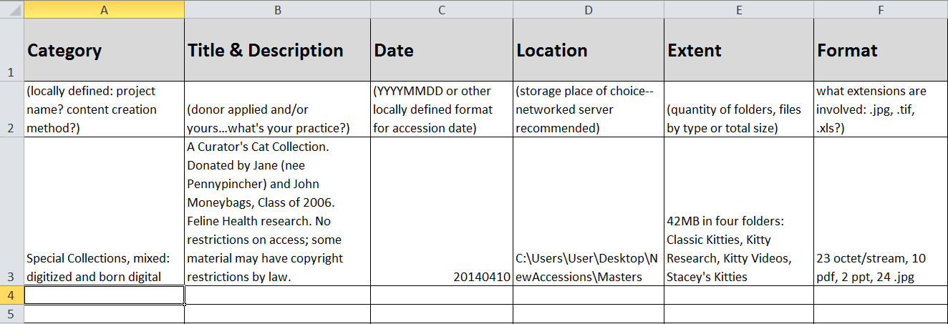
Notes:
I use a database for gathering accession information. Here’s what an Excel version of the Library of Congress’s recommended metadata looks like. I wanted to include donor information with my inventory and added to description—I could have made a new column for it, too.
Saving and backing up this information about our objects is important as well!

Slide 28

National Digital Stewardship Alliance
Definition of “basic” fixity: expected file size and file count on information capture.
Example: Does the detailed view in a file window show a size of
0 bytes? Does your donation form (or the donor’s emailed
message!) list quantity and does that match the attachment?
More complexity of file analysis possible with checksum tools and systems (not our focus today).
Notes:
Other groups are involved in setting national standards. You’ve seen examples from the Library of Congress. Another one of them is NDSA. What my POWRR group found striking is that there are similarities with what we all already do.
We already collect information on accession for our analog content. But we need to be explicit with quantity and type of files due to the inherent vices I mentioned. We need to know file formats and their age in order to help us understand the types of software that might have been used as time passes. And then there is our future selves—the others who come into our jobs later—that we need to think of. They will need clues about how to follow up on what we learned from our donors.

Slide 29
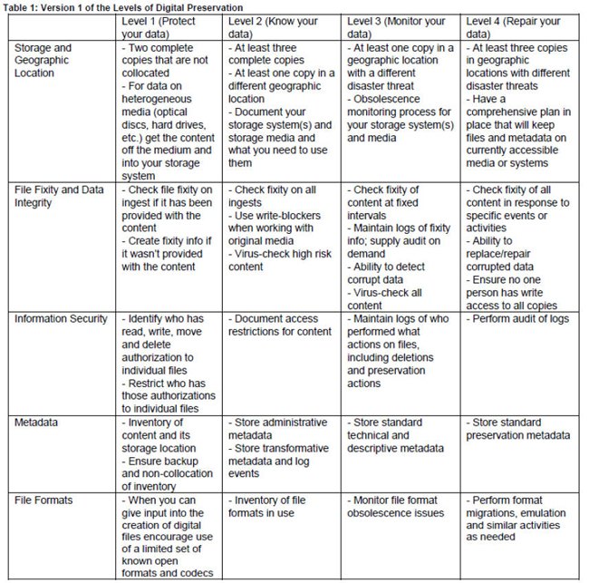
http://www.digitalpreservation.gov/ndsa/activities/levels.html
Notes:
When we think about preserving digital objects, we have to choose what we’re going to try defending against. Knowing what you want to preserve and at what level is important. And knowing exactly what kind of content we have is the start of that process.
During the course of our project, the Digital POWRR team looked at a lot of things other people created while working on DP issues. This table is something we found to be helpful in thinking through what steps we can take in preserving our objects now and ones we can start planning for.
I wanted you to have it as a take away reminder of the different levels of preservations digital objects might need (across the top row) and for the changes in attributes to consider for each level (column 1). The copy in your packet printed a little fuzzy, but the URL is printed for you.
This chart is version 1…like everyone else, the NDSA’s recommendations are a work in progress!!! Your handout contains this url so you can stay informed about any updates.

Slide 30
Collection decision points
Fact: Not every e-record needs the maximum amount of protection.
How will you decide what can be stored in-house, what goes to the cloud and what might need automatic monitoring?
Notes:
Not all of the content we keep will receive the same level of treatment. This is a major concept that distinguishes digital from analog. Remember you can refer to the NDSA Levels document for help. There are other decision making tools, too, of course.

Slide 31
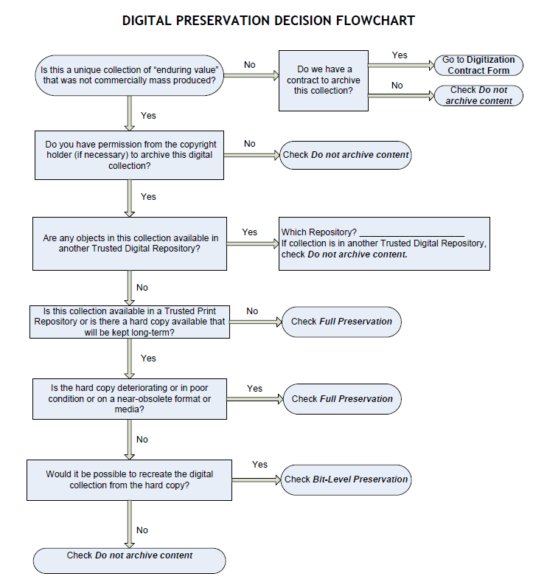
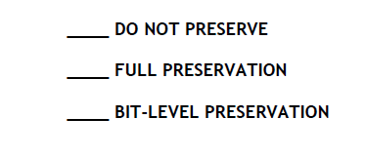
Courtesy of: Tawnya Keller, Digital Preservation Archivist
University of Utah
Notes:
This flowchart (also in handout) is another tool someone created that we found to be helpful in thinking through what might need protection and at what level. This workflow starts by asking if they need to make a collection digital, but you can just as easily start with the second step (first box) in the left column.
Note that on your handout there is a side 2 to help define the different decision points. This is a locally created workflow and so their terminology matches their local needs.

Slide 32
Collection decision points
Questions that are best thought through sooner rather than later: 1) Does the e-content go with already acquired material, or 2) Are you being asked to take it just because it’s digital and doesn’t take up “space”?
Stick to your Collection Development Plan!
Notes:
Final thought on collection content: Space is an issue, especially with the proliferation of A/V material but quality of this content is also an issue. You have to decide what you are going to care for just like you do with anything else.

Slide 33
Storage decision points
Not every storage device is created equal.
Remember: two copies in distributed storage is the minimum. Can you do this locally? Collaborate with a similar institution? Or will you be able to use a product or vendor?
How will you decide the type of storage to use?
Hint: This goes back to the collection decision point about what level of preservation you decide your content needs.
Notes:
Now I will turn to specifics about storage choices. We’ll go back to the initial part of this presentation. Remember: Storage & access are different from preservation.
I felt it necessary to dwell on the difference to get us thinking along the same lines today, but there are ways that you can use widespread storage devices if you keep these preservation concerns in mind: one external hard drive for mass collections will not be good enough and not all Clouds have silver linings.

Slide 34
Storage decision points
Is public access necessary?
And how do you define public—organizational or Google-able?
Does the access system have to be the same as the storage system? Will you have ability to provide reference/access on a one-on-one basis? Or the cafeteria-style of letting people retrieve their own content?
Guess which costs more in money and/or time!
Notes:
Ties back to donor agreements and collection policies. What are you promising your communities of users?

Slide 35
Storage decision types
Distributed storage through collaboration
With IT, you might choose networked transfer of sites or even specific record types with another organization.
If no IT, go old school and swap hard drives with someone you trust on a regular basis!
If no one to swap with use RAID (Redundant Array of Independent Discs) drives as a start.
Notes:
Remember, if you are relying on hard drives or other storage media for transfer that you need to replace it about every five years.

Slide 36
Storage decision types
Distributed storage up in the Clouds
Free but open to the world: Internet Archive. The lower cost, web-crawling product Archive-It does allow for file restrictions.
Commercial Cloud service providers. Numerous but not all equal…Check the fine print!
Notes:
I think Internet Archive is an excellent choice for most small institutions or people without many staff, but the free version requires you to have the content available freely online.
Mention that Amazon’s Glacier is available as standalone distributed storage and also a back-end option with 2 of the 4 backend systems/products that we tested…more on this to come.

Slide 37
Storage decision types
Distributed storage with geographic plus!
Moderate cost: DuraCloud
Allows open or closed file access. Includes fixity checks (AKA checksums, “health checks”)
Full service for a variable cost: Preservica
All of the above plus automatic file normalizing and an option to provide a public interface.
Notes:
DuraCloud does not require a lot of technical know-how and allows you to provide others with links to specific materials you store there.
Preservica offers a suite of services including an interface your community of users can access content from without you (only for what you set open permissions for).

Slide 38
Remember this?
Most tools and services only perform some of the functions in a digital curation lifecycle.
And there are back-end storage/preservation services like…..
There are front-end/processing tools like…..
MetaArchive DuraCloud Amazon Glacier
Internet Archive
Duke Data Accessioner Archivematica
But there are a few that will pretty much do it all like….
Preservica Dspace Direct (uses DuraCloud)
Please Keep In Mind…
This is NOT exhaustive. Software changes quickly! Based on availability at time of testing and our perceived needs.
Notes:
Explain what we mean by processing and backend. We’re not detailing processing tools today but this is part of the awareness you can start developing for future decisions.
Details on these specific tools are available on our project website and the tool grid we created.

Slide 39
Don’t Panic - Your Pre-Ingest Workflow aka Wrangling your digital stuff before you can get it into a shiny system
NOTE: This is only ONE way to do this… Everyone’s workflow is a little different!
Starting from scratch:
Begin an Inventory Spreadsheet
Move everything to a stable carrier (like a network drive)
Make an Access Copy from your Master Copy
Note these locations in your Inventory Spreadsheet
OPTIONAL: Keep original media
Most of these will cost you more time than money
Document what you do pre-ingest. For future you.
Remember: Good enough is just fine. For now.
Notes:
I’m sure this is all sounding pretty complicated, but the summary of this part is that you need to make a list of what you have and make a decision about a way of doing distributed storage that’s logical for your organization.

Slide 40
CONGRATULATIONS!
We call this “Digital Preservation in Your Office”
There are things that need to happen outside of your office as well….

Slide 41
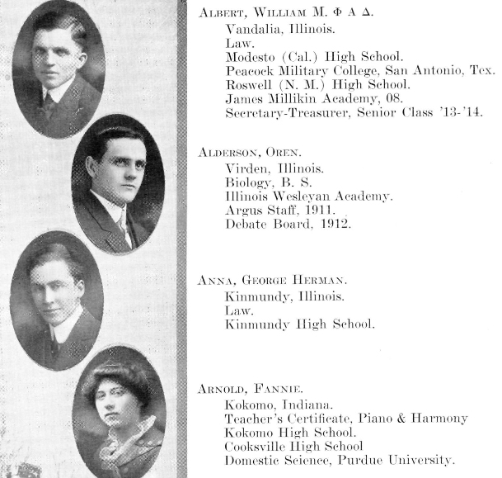
A tale of two centuries: Class of 1914
Notes:
Here’s an example of why you can’t keep your new knowledge about fragile digital objects to yourself.
IWU Class of 1914. Records left behind: Senior Class pictures, hometown and activities, printed publications, course descriptions.
An archivist’s life was good (and less complicated) until the mid-1990s.

Slide 42

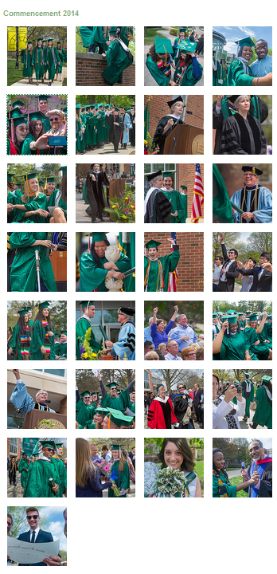

A tale of two centuries: Class of 2014
Their legacy is locked up in scattered social media sites—personal and organizational—and who has access?
Not me!
Notes:
Records left behind: Class picture (not anymore—only small group shots and most individuals not identified), printed publications (some group publications plus the Commencement program), course descriptions (still printed, but more moving online).
How many of you can say this about your Chapters? What type of information are you usually asked about them? How will you make sure you continue to get this?
All of these represent cultural shifts. Our desire to collect our heritage hasn’t changed and our processes for collecting lag behind the technologies and impulses of creation and sharing. These are our challenges and we can’t face them alone.
The solution to this problem is in outreach to our communities!

Slide 43
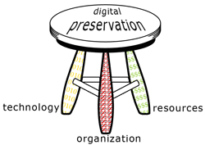
Outside Your Office
Digital Preservation is not sustainable by just using a tool or selecting a service. Sustainability takes funding and people.
You cannot do this alone. You will need to talk to other people… because you are not the only boss of this.
Successful Digital Preservation programs take a team of people at multiple administrative levels.
Three-Legged Stool of Digital Preservation
Anne R. Kenney
Nancy McGovern
Digital Preservation Management Workshop
http://www.dpworkshop.org/
Notes:
A fully implemented and viable preservation program addresses organizational issues, technological concerns, and funding questions, balancing them like a three-legged stool.
Organizational Infrastructure includes the policies, procedures, practices, people—the elements that any programmatic area needs to thrive, but specialized to address digital preservation requirements. It addresses this key development question:
What are the requirements and parameters for the organization's digital preservation program?
0101 Technological Infrastructure consists of the requisite equipment, software, hardware, a secure environment, and skills to establish and maintain the digital preservation program. It anticipates and responds wisely to changing technology. It addresses this key development question:
How will the organization meet defined digital preservation requirements?
$$$$ Resources Framework addresses the requisite startup, ongoing, and contingency funding to enable and sustain the digital preservation program. It addresses this key development question:
What resources will it take to develop and maintain the organization’s digital preservation program?

Slide 44
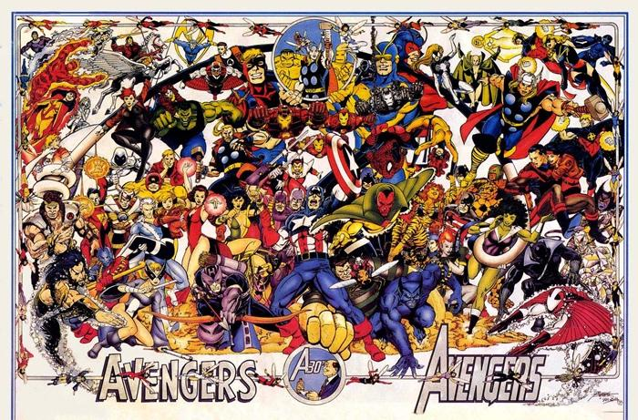
Assemble Your Team!
Image: Flickr Commons
Notes:
For our final group activity, you’re going to help each other think through who you can approach for help with getting this done.

Slide 45
Outside Your Office Group Activity: 3-3-3 Action Plan
Create a list of all roles in an organization that should
play a part in some aspect of digital preservation.
Board? IT? Content creators?
Notes:
Handout called 3-3-3 action plan. Give them a couple of minutes to brainstorm some on their own (or in small groups based on institution type…)

Slide 46
3-3-3 Action Plan: Build Your Team
Now let’s move from roles to people….
On your 3-3-3 Action Plan handout, list 3 individuals at your institution in these roles that you already have a working relationship with.
Which of these folks are you willing to contact in the next 2 weeks? …in the following month? …in the following 3 months?
After bringing these colleagues on board, what are 3 concrete, small steps that you can take together to move your burgeoning DP program forward?
~Conversations/Meetings ~Inventory what you already have
~Enhance the metadata of the records you already have
~Look at how current policies address digital materials (ex. collection development)
~Tool investigation: Dig a little deeper on tools that piqued your interest today
~Look at other institutions’ DP policies with an eye to crafting your own
~Engage in some outreach/education activities…host a Brown Bag!
~Read the POWRR white paper
Notes:
If no time, fill out the rest at home. Don’t forget to ask each other—you new-found digital preservation friends—for ideas in the future!
I can imagine that some of you might not “already have a working relationship” with people in the roles listed. Maybe add this as a point for emphasis.
Think of it as moving even one square to the right on the NDSA Levels of Preservation grid

Slide 47
Advocacy Before Policy
Advocacy is valuable because you’re educating people about why digital preservation is also THEIR problem.
- Our one-pagers may help you frame why digital preservation is important to different jobs/function.
- The risks of doing nothing are a lot greater than they may think.
Good policies incorporate multiple viewpoints.
Other people in your organizations will bring up issues – and possible solutions – you may have missed.
You will discover many things that you don’t directly control that still directly affect your work. This will lead you to more people to add to your team.
Notes:
Have them get out one pagers here! The final handout has two sides for two different audiences. Others are possible, and we’ve created similar arguments on templates you can use to modify for your needs. We have messages for administrators, fundraisers, IT and budget/finance people. You are welcome to make your own messages with our templates!
Academic focus but you can translate to meet your needs.

Slide 48
Wrapping Up
Our Final Thoughts & Your Questions
I survived the POWRR workshop! Now what? https://digitalPOWRR.niu.edu/survived-powrr-wkshp/
We’re here to help. Seriously.
YOU CAN DO THIS. Really. But not alone. So bring some friends.
“If you want to go fast…go alone. If you want to go far…go together.” — African Proverb
Advocacy, Policy and Workflow function best when they are aligned.
Remember: Baby steps still move you forward!

Slide 49
POWRR Project Team Members Contact us…we are here to help!
Northern Illinois University Lynne M. Thomas Curator, RBSC lmthomas@niu.edu 815.753.0255
Drew VandeCreek Director Digital Scholarship drew@niu.edu 815.753.7179
Jaime Schumacher Digital POWRR Director jschumacher@niu.edu 815.753.0576
Stacey Erdman Digital Collections Curator serdman@niu.edu 815.753.1004
Danielle Spalenka Regional Hist Cntr Curator dspalenka@niu.edu 815.753.9394
Matthew Short Metadata Librarian mshort@niu.edu 815.753.9868
Nathan Books Technical Associate nbooks@niu.edu 815.753.9653
Chicago State University Aaisha Haykal University Archivist ahaykal@csu.edu 773.995.3843
Martin Kong Systems Librarian mkong@csu.edu 773.995.3908
Illinois State University Patrice-Andre Prud’homme Digital Collections Head ppprudh@ilstu.edu 309.438.5385
Illinois Wesleyan University *Meg Miner University Archivist mminer@iwu.edu 309.556.1538
Western Illinois University Jeff Hancks Director, Archives and Special Collections jl-hancks@wiu.edu 309.298.2717
* Presented at National Archives Conference for Fraternities and Sororities

